Slide 1

Advanced Computer Networking & Communications
CSC 815 Module 2 - Communication Concepts and
Physical layer
Engr. Prof. Steve A. Adeshina
Prof S.A Adeshina
NILE

Slide 2
Communication concepts
Prof S.A Adeshina
NILE

Slide 3
Transmission Terminology
data transmission occurs between a transmitter & receiver via some medium
guided medium
eg. twisted pair, coaxial cable, optical fiber
unguided / wireless medium
eg. air, water, vacuum
Prof S.A Adeshina
NILE
Notes:
The first section presents some concepts and terms from the field of electrical engineering. This should provide sufficient background to deal with the remainder of the chapter. Data transmission occurs between transmitter and receiver over some transmission medium. Transmission media may be classified as guided or unguided. In both cases, communication is in the form of electromagnetic waves. With guided media, the waves are guided along a physical path; examples of guided media are twisted pair, coaxial cable, and optical fiber. Unguided media, also called wireless, provide a means for transmitting electromagnetic waves but do not guide them; examples are propagation through air, vacuum, and seawater.

Slide 4
Transmission Terminology
direct link
no intermediate devices
point-to-point
direct link
only 2 devices share link
multi-point
more than two devices share the link
Prof S.A Adeshina
NILE
Notes:
The term direct link is used to refer to the transmission path between two devices in which signals propagate directly from transmitter to receiver with no intermediate devices, other than amplifiers or repeaters used to increase signal strength. A guided transmission medium is point to point if it provides a direct link between two devices and those are the only two devices sharing the medium. In a multipoint guided configuration, more than two devices share the same medium.

Slide 5
Transmission Terminology
simplex
one direction
eg. television
half duplex
either direction, but only one way at a time
eg. police radio
full duplex
both directions at the same time
eg. telephone
Prof S.A Adeshina
NILE
Notes:
A transmission may be simplex, half duplex, or full duplex. In simplex transmission, signals are transmitted in only one direction; one station is transmitter and the other is receiver. In half-duplex operation, both stations may transmit, but only one at a time. In full-duplex operation, both stations may transmit simultaneously, and the medium is carrying signals in both directions at the same time.
We should note that the definitions just given are the ones in common use in the United States (ANSI definitions). Elsewhere (ITU-T definitions), the term simplex is used to correspond to half duplex and duplex is used to correspond to full duplex.

Slide 6
Frequency, Spectrum and Bandwidth
time domain concepts
analog signal
various in a smooth way over time
digital signal
maintains a constant level then changes to another constant level
periodic signal
pattern repeated over time
A periodic signal
pattern not repeated over time
Prof S.A Adeshina
NILE
Notes:
In this book, we are concerned with electromagnetic signals used as a means to transmit data. The signal is a function of time, but it can also be expressed as a function of frequency; that is, the signal consists of components of different frequencies. It turns out that the frequency domain view of a signal is more important to an understanding of data transmission than a time domain view.
Viewed as a function of time, an electromagnetic signal can be either analog or digital. An analog signal is one in which the signal intensity varies in a smooth fashion over time. A digital signal is one in which the signal intensity maintains a constant level for some period of time and then abruptly changes to another constant level. This is an idealized definition. In fact, the transition from one voltage level to another will not be instantaneous, but there will be a small transition period.
The simplest sort of signal is a periodic signal, in which the same signal pattern repeats over time. Otherwise, a signal is aperiodic.

Slide 7
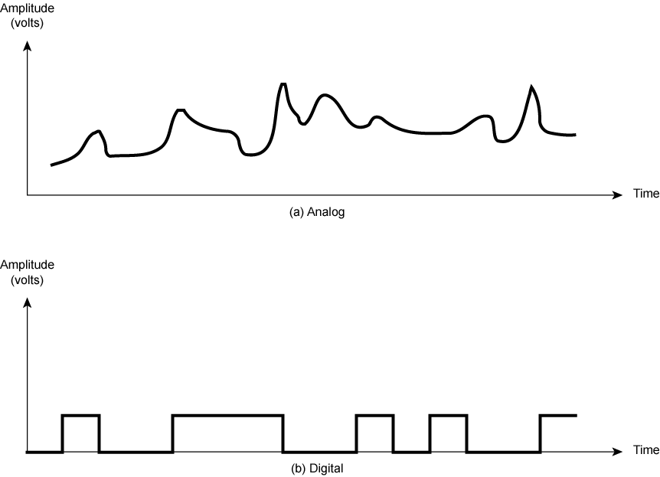
Analogue & Digital Signals
Prof S.A Adeshina
NILE
Notes:
Stallings DCC8e Figure 3.1 shows an example of both analog or digital signals. The continuous signal might represent speech, and the discrete signal might represent binary 1s and 0s.

Slide 8
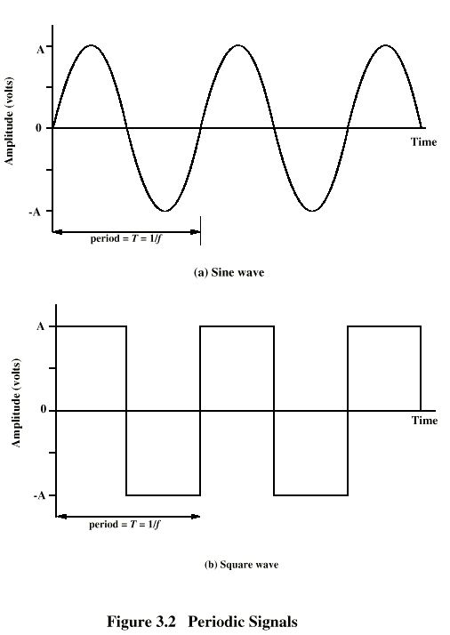
Periodic Signals
Prof S.A Adeshina
NILE
Notes:
In Stallings DCC8e Figure 3.2 a signal is generated by the transmitter and transmitted over a medium. The signal is a function of time, but it can also be expressed as a function of frequency; that is, the signal consists of components of different frequencies. It turns out that the frequency domain view of a signal is more important to an understanding of data transmission than a time domain view. Both views are introduced here.

Slide 9
Sine Wave
peak amplitude (A)
maximum strength of signal
volts
frequency (f)
rate of change of signal
Hertz (Hz) or cycles per second
period = time for one repetition (T)
T = 1/f
phase (φ)
relative position in time
Prof S.A Adeshina
NILE
Notes:
The sine wave is the fundamental periodic signal. A general sine wave can be represented by three parameters:
peak amplitude (A) - the maximum value or strength of the signal over time; typically measured in volts.
frequency (f) - the rate [in cycles per second, or Hertz (Hz)] at which the signal repeats. An equivalent parameter is the period (T) of a signal, so T = 1/f.
phase (φ) - measure of relative position in time within a single period of a signal, illustrated subsequently

Slide 10
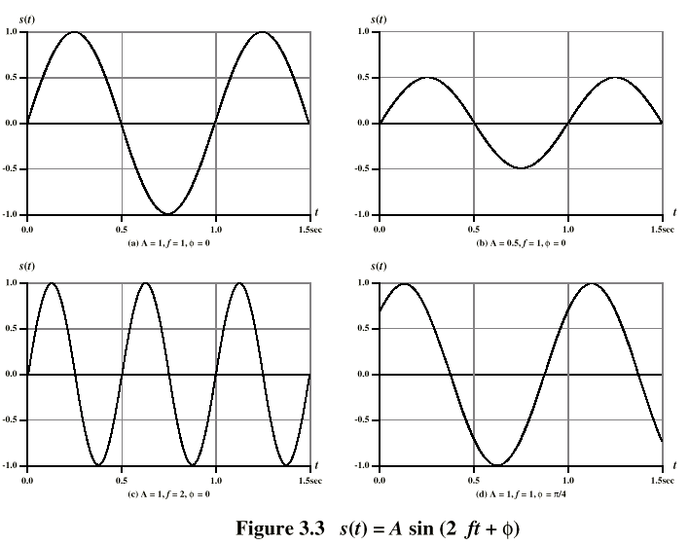
Varying Sine Waves s(t) = A sin(2πft +Φ)
Prof S.A Adeshina
NILE
Notes:
The general sine wave can be written as: s(t) = A sin(2πft + φ), known as a sinusoid function.
Stallings DCC8e Figure 3.3 shows the effect of varying each of the three parameters, the horizontal axis is time; the graphs display the value of a signal at a given point in space as a function of time. In part (a) of the figure, the frequency is 1 Hz; thus the period is T = 1 second. Part (b) has the same frequency and phase but a peak amplitude of 0.5. In part (c) we have f = 2, which is equivalent to T = 0.5. Finally, part (d) shows the effect of a phase shift of π/4 radians, which is 45 degrees (2π radians = 360˚ = 1 period).
These same graphs, with a change of scale, can apply with horizontal axes in space. In this case, the graphs display the value of a signal at a given point in time as a function of distance.

Slide 11
Wavelength (λ)
is distance occupied by one cycle
between two points of corresponding phase in two consecutive cycles
assuming signal velocity v have λ = vT
or equivalently λf = v
especially when v=c
c = 3*10⁸ ms⁻¹ (speed of light in free space)
Prof S.A Adeshina
NILE
Notes:
There is a simple relationship between the two sine waves, one in time and one in space. The wavelength (λ) of a signal is the distance occupied by a single cycle, or, put another way, the distance between two points of corresponding phase of two consecutive cycles. Assume that the signal is traveling with a velocity v. Then the wavelength is related to the period as follows: λ = vT. Equivalently, λf = v. Of particular relevance to this discussion is the case where v = c, the speed of light in free space, which is approximately 3 × 10⁸ m/s.

Slide 12
Frequency Domain Concepts
signal are made up of many frequencies
components are sine waves
Fourier analysis can shown that any signal is made up of component sine waves
can plot frequency domain functions
Prof S.A Adeshina
NILE
Notes:
Stoppped here for NITDA MSc. 21/10/2019
In practice, an electromagnetic signal will be made up of many frequencies. It can be shown, using a discipline known as Fourier analysis, that any signal is made up of components at various frequencies, in which each component is a sinusoid. By adding together enough sinusoidal signals, each with the appropriate amplitude, frequency, and phase, any electromagnetic signal can be constructed.

Slide 13
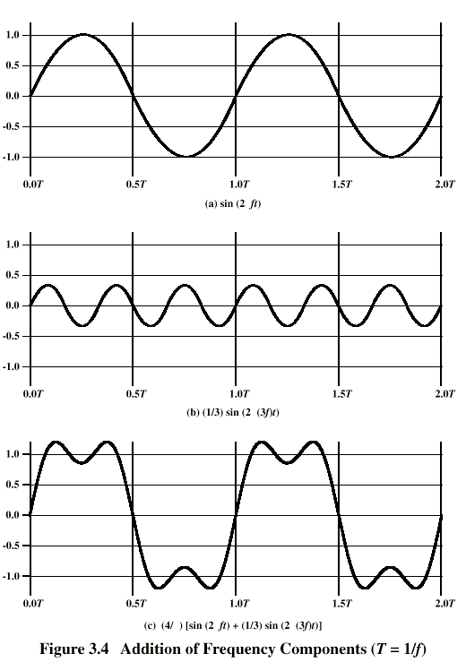
Addition of Frequency Components (T=1/f)
c is sum of f & 3f
Prof S.A Adeshina
NILE
Notes:
In Stallings DCC8e Figure 3.4c, the components of this signal are just sine waves of frequencies f and 3f, as shpwn in parts (a) and (b).

Slide 14
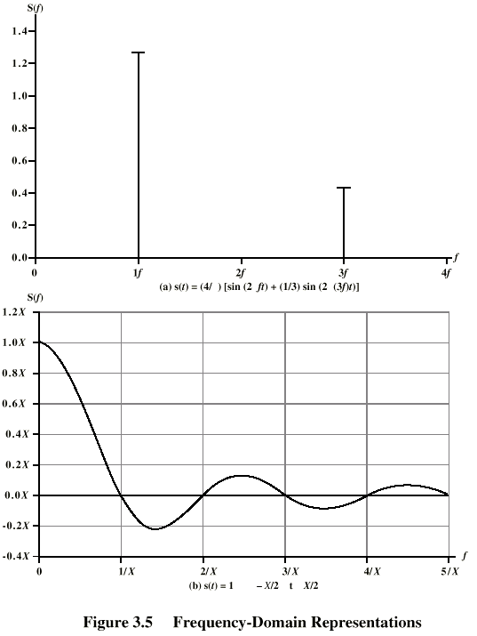
Frequency Domain Representations
freq domain func
freq domain func of single square pulse
Prof S.A Adeshina
NILE
Notes:
So we can say that for each signal, there is a time domain function s(t) that specifies the amplitude of the signal at each instant in time. Similarly, there is a frequency domain function S(f) that specifies the peak amplitude of the constituent frequencies of the signal.
In Stallings DCC8e Figure 3.5a shows the frequency domain function for the signal of Figure 3.4c. Note that, in this case, S(f) is discrete. Figure 3.5b shows the frequency domain function for a single square pulse that has the value 1 between –X/2 and X/2, and is 0 elsewhere. Note that in this case S(f) is continuous and that it has nonzero values indefinitely, although the magnitude of the frequency components rapidly shrinks for larger f. These characteristics are common for real signals.

Slide 15
Spectrum & Bandwidth
spectrum
range of frequencies contained in signal
absolute bandwidth
width of spectrum
effective bandwidth
often just bandwidth
narrow band of frequencies containing most energy
DC Component
component of zero frequency
Prof S.A Adeshina
NILE
Notes:
The spectrum of a signal is the range of frequencies that it contains. For Stallings DCC8e Fig 3.4c, it extends from f to 3f.
The absolute bandwidth of a signal is the width of the spectrum (eg is 2f in Fig 3.4c. Many signals, such as that of Figure 3.5b, have an infinite bandwidth.
Most of the energy in the signal is contained in a relatively narrow band of frequencies known as the effective bandwidth, or just bandwidth.
If a signal includes a component of zero frequency, it is a direct current (dc) or constant component.

Slide 16
Data Rate and Bandwidth
any transmission system has a limited band of frequencies
this limits the data rate that can be carried
square have infinite components and hence bandwidth
but most energy in first few components
limited bandwidth increases distortion
have a direct relationship between data rate & bandwidth
Prof S.A Adeshina
NILE
Notes:
Although a given waveform may contain frequencies over a very broad range, as a practical matter any transmission system (transmitter plus medium plus receiver) will be able to accommodate only a limited band of frequencies. This, in turn, limits the data rate that can be carried on the transmission medium.
A square wave has an infinite number of frequency components and hence an infinite bandwidth. However, the peak amplitude of the kth frequency component, kf, is only 1/k, so most of the energy in this waveform is in the first few frequency components.
In general, any digital waveform will have infinite bandwidth. If we attempt to transmit this waveform as a signal over any medium, the transmission system will limit the bandwidth that can be transmitted. For any given medium, the greater the bandwidth transmitted, the greater the cost. The more limited the bandwidth, the greater the distortion, and the greater the potential for error by the receiver.
There is a direct relationship between data rate and bandwidth: the higher the data rate of a signal, the greater is its required effective bandwidth.

Slide 17
Analog and Digital Data Transmission
data
entities that convey meaning
signals & signalling
electric or electromagnetic representations of data, physically propagates along medium
transmission
communication of data by propagation and processing of signals
Prof S.A Adeshina
NILE
Notes:
Have seen already that analog and digital roughly correspond to continuous and discrete respectively.
Define data as entities that convey meaning, or information.
Signals are electric or electromagnetic representations of data.
Signaling is the physical propagation of the signal along a suitable medium.
Transmission is the communication of data by the propagation and processing of signals.

Slide 18
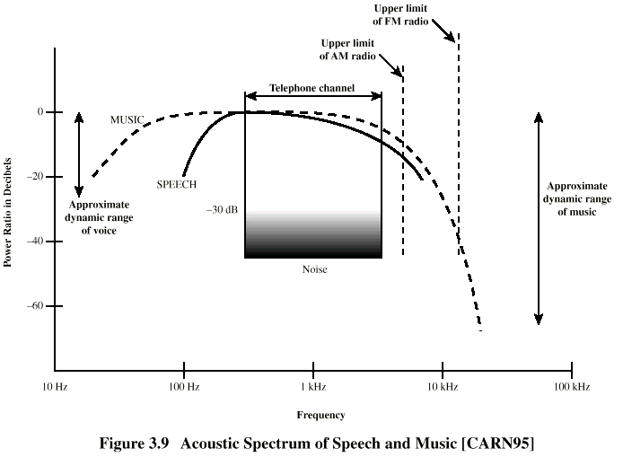
Acoustic Spectrum (Analog)
Prof S.A Adeshina
NILE
Notes:
Analog data take on continuous values in some interval, the most familiar example being audio, which, in the form of acoustic sound waves, can be perceived directly by human beings.
Stallings DCC8e Figure 3.9 shows the acoustic spectrum for human speech and for music (note log scales). Frequency components of typical speech may be found between approximately 100 Hz and 7 kHz, and has a dynamic range of about 25 dB (a shout is approx 300 times louder than whisper).
Another common example of analog data is video, as seen on a TV screen.

Slide 19
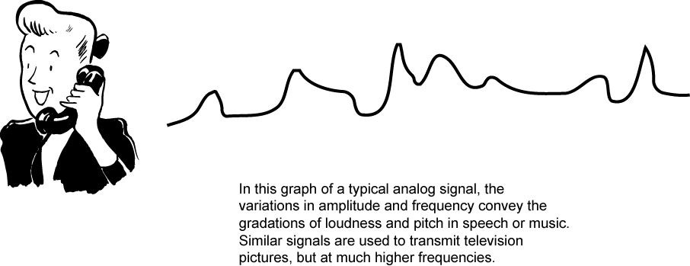
Audio Signals
freq range 20Hz-20kHz (speech 100Hz-7kHz)
easily converted into electromagnetic signals
varying volume converted to varying voltage
can limit frequency range for voice channel to 300-3400Hz
Prof S.A Adeshina
NILE
Notes:
The most familiar example of analog information is audio/acoustic sound wave information, eg. human speech. It is easily converted to an electromagnetic signal for transmission as shown in Stallings DCC8e Figure 3.12. All of the sound frequencies, whose amplitude is measured in terms of loudness, are converted into electromagnetic frequencies, whose amplitude is measured in volts. The telephone handset contains a simple mechanism for making such a conversion. In the case of acoustic data (voice), the data can be represented directly by an electromagnetic signal occupying the same spectrum. The spectrum of speech is approximately 100 Hz to 7 kHz, although a much narrower bandwidth will produce acceptable voice reproduction. The standard spectrum for a voice channel is 300 to 3400 Hz.

Slide 20
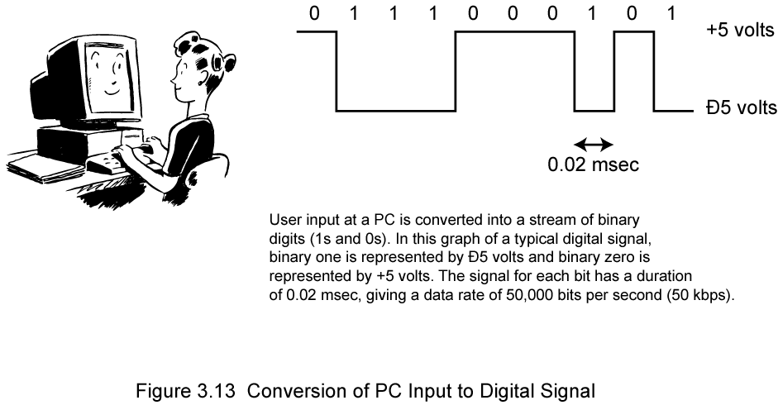
Digital Data
as generated by computers etc.
has two dc components
bandwidth depends on data rate
Prof S.A Adeshina
NILE
Notes:
Lastly consider binary data, as generated by terminals, computers, and other data processing equipment and then converted into digital voltage pulses for transmission. This is illustrated in Stallings DCC8e Figure 3.13. A commonly used signal for such data uses two constant (dc) voltage levels, one level for binary 1 and one level for binary 0. Consider the bandwidth of such a signal, which depends on the exact shape of the waveform and the sequence of 1s and 0s. The greater the bandwidth of the signal, the more faithfully it approximates a digital pulse stream.

Slide 21
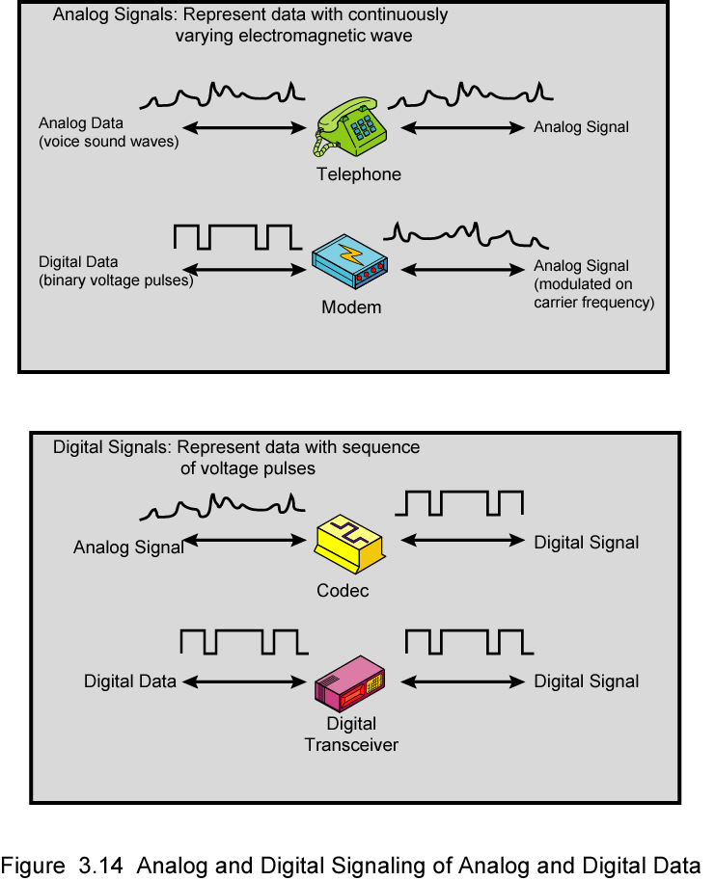
Analog Signals
Prof S.A Adeshina
NILE
Notes:
In a communications system, data are propagated from one point to another by means of electromagnetic signals. Both analog and digital signals may be transmitted on suitable transmission media.
An analog signal is a continuously varying electromagnetic wave that may be propagated over a variety of media, depending on spectrum; examples are wire media, such as twisted pair and coaxial cable; fiber optic cable; and unguided media, such as atmosphere or space propagation.
As Stallings DCC8e Figure 3.14 illustrates, analog signals can be used to transmit both analog data represented by an electromagnetic signal occupying the same spectrum, and digital data using a modem (modulator/demodulator) to modulate the digital data on some carrier frequency.
However, analog signal will become weaker (attenuate) after a certain distance. To achieve longer distances, the analog transmission system includes amplifiers that boost the energy in the signal. Unfortunately, the amplifier also boosts the noise components. With amplifiers cascaded to achieve long distances, the signal becomes more and more distorted. For analog data, such as voice, quite a bit of distortion can be tolerated and the data remain intelligible. However, for digital data, cascaded amplifiers will introduce errors.

Slide 22
Digital Signals
Prof S.A Adeshina
NILE
Notes:
A digital signal is a sequence of voltage pulses that may be transmitted over a wire medium; eg. a constant positive voltage level may represent binary 0 and a constant negative voltage level may represent binary 1.
As Stallings DCC8e Figure 3.14 also illustrates, digital signals can be used to transmit both analog signals and digital data. Analog data can converted to digital using a codec (coder-decoder), which takes an analog signal that directly represents the voice data and approximates that signal by a bit stream. At the receiving end, the bit stream is used to reconstruct the analog data. Digital data can be directly represented by digital signals.
A digital signal can be transmitted only a limited distance before attenuation, noise, and other impairments endanger the integrity of the data. To achieve greater distances, repeaters are used. A repeater receives the digital signal, recovers the pattern of 1s and 0s, and retransmits a new signal. Thus the attenuation is overcome.

Slide 23
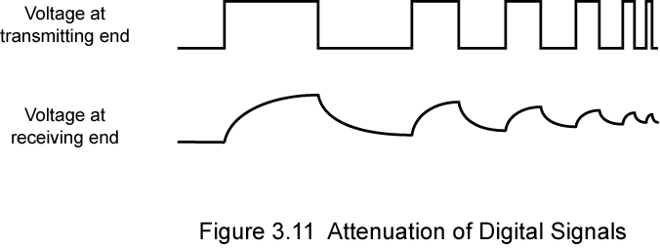
Advantages & Disadvantages of Digital Signals
cheaper
less susceptible to noise
but greater attenuation
digital now preferred choice
Prof S.A Adeshina
NILE
Notes:
The principal advantages of digital signaling are that it is generally cheaper than analog signaling and is less susceptible to noise interference. The principal disadvantage is that digital signals suffer more from attenuation than do analog signals. Stallings DCC8e Figure 3.11 shows a sequence of voltage pulses, generated by a source using two voltage levels, and the received voltage some distance down a conducting medium. Because of the attenuation, or reduction, of signal strength at higher frequencies, the pulses become rounded and smaller.
Which is the preferred method of transmission? The answer being supplied by the telecommunications industry and its customers is digital. Both long-haul telecommunications facilities and intra-building services have moved to digital transmission and, where possible, digital signaling techniques, for a range of reasons.

Slide 24
Transmission Impairments
signal received may differ from signal transmitted causing:
analog - degradation of signal quality
digital - bit errors
most significant impairments are
attenuation and attenuation distortion
delay distortion
noise
Prof S.A Adeshina
NILE
Notes:
With any communications system, the signal that is received may differ from the signal that is transmitted due to various transmission impairments. For analog signals, these impairments can degrade the signal quality. For digital signals, bit errors may be introduced, such that a binary 1 is transformed into a binary 0 or vice versa.
End of Class 14102017

Slide 25
Attenuation
where signal strength falls off with distance
depends on medium
received signal strength must be:
strong enough to be detected
sufficiently higher than noise to receive without error
so increase strength using amplifiers/repeaters
is also an increasing function of frequency
so equalize attenuation across band of frequencies used
eg. using loading coils or amplifiers
Prof S.A Adeshina
NILE
Notes:
Attenuation is where the strength of a signal falls off with distance over any transmission medium. For guided media, this is generally exponential and thus is typically expressed as a constant number of decibels per unit distance. For unguided media, attenuation is a more complex function of distance and the makeup of the atmosphere. See Stallings DCC8e Figure 3.11 on previous slide for illustration of attenuation.
Attenuation introduces three considerations for the transmission engineer. First, a received signal must have sufficient strength so that the electronic circuitry in the receiver can detect the signal. Second, the signal must maintain a level sufficiently higher than noise to be received without error. Third, attenuation varies with frequency. The first and second problems are dealt with by attention to signal strength and the use of amplifiers or repeaters. The third problem is particularly noticeable for analog signals. To overcome this problem, techniques are available for equalizing attenuation across a band of frequencies. This is commonly done for voice-grade telephone lines by using loading coils that change the electrical properties of the line; the result is to smooth out attenuation effects. Another approach is to use amplifiers that amplify high frequencies more than lower frequencies.

Slide 26
The Theoretical Basis for Data Communication
Fourier Analysis
Bandwidth-Limited Signals
Maximum Data Rate of a Channel
Prof S.A Adeshina
NILE

Slide 27
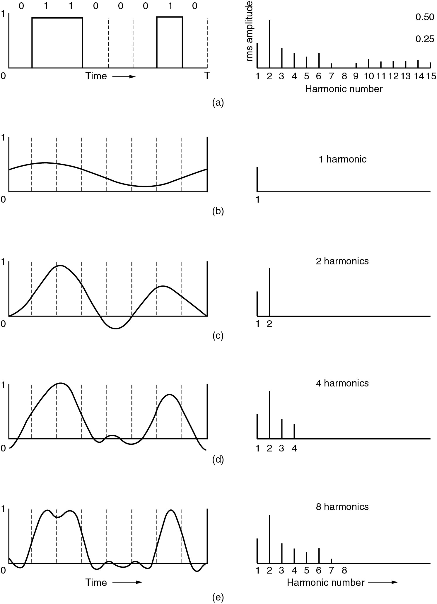
Bandwidth-Limited Signals
A binary signal and its root-mean-square Fourier amplitudes.
(b) – (c) Successive approximations to the original signal.
Prof S.A Adeshina
NILE

Slide 28
Bandwidth-Limited Signals (2)
(d) – (e) Successive approximations to the original signal.
Prof S.A Adeshina
NILE

Slide 29
Guided Transmission Data
Magnetic Media
Twisted Pair
Coaxial Cable
Fiber Optics
Prof S.A Adeshina
NILE

Slide 30
Twisted Pair
(a) Category 3 UTP.
(b) Category 5 UTP.
Prof S.A Adeshina
NILE

Slide 31
Comparison of Shielded and Unshielded Twisted Pair
Prof S.A Adeshina
NILE
Notes:
Stallings DCC8e Table 4.2 summarizes the performance of Category 3 and 5 UTP, as well as the STP specified in EIA-568-A
The first parameter used for comparison, attenuation, is fairly straightforward. The strength of a signal falls off with distance over any transmission medium. For guided media attenuation is generally exponential and therefore is typically expressed as a constant number of decibels per unit distance.
Near-end crosstalk as it applies to twisted pair wiring systems is the coupling of the signal from one pair of conductors to another pair. These conductors may be the metal pins in a connector or wire pairs in a cable. The near end refers to coupling that takes place when the transmit signal entering the link couples back to the receive conductor pair at that same end of the link (i.e., the near transmitted signal is picked up by the near receive pair).

Slide 32
Near End Crosstalk
coupling of signal from one pair to another
occurs when transmit signal entering the link couples back to receiving pair
ie. near transmitted signal is picked up by near receiving pair
Prof S.A Adeshina
NILE
Notes:
Near-end crosstalk as it applies to twisted pair wiring systems is the coupling of the signal from one pair of conductors to another pair. These conductors may be the metal pins in a connector or wire pairs in a cable. The near end refers to coupling that takes place when the transmit signal entering the link couples back to the receive conductor pair at that same end of the link (ie. the near end transmitted signal is picked up by the near receive pair).

Slide 33
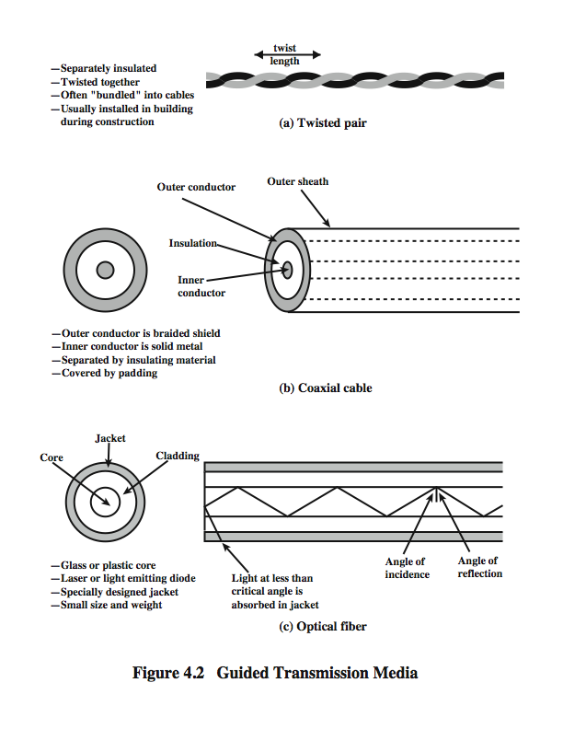
Coaxial Cable
Prof S.A Adeshina
NILE
Notes:
Coaxial cable, like twisted pair, consists of two conductors, but is constructed differently to permit it to operate over a wider range of frequencies. It consists of a hollow outer cylindrical conductor that surrounds a single inner wire conductor (Stallings DCC8e Figure 4.2b). The inner conductor is held in place by either regularly spaced insulating rings or a solid dielectric material. The outer conductor is covered with a jacket or shield. A single coaxial cable has a diameter of from 1 to 2.5 cm. Coaxial cable can be used over longer distances and support more stations on a shared line than twisted pair.
Coaxial cable is a versatile transmission medium, used in a wide variety of applications, including:
• Television distribution - aerial to TV & CATV systems
• Long-distance telephone transmission - traditionally used for inter-exchange links, now being replaced by optical fiber/microwave/satellite
• Short-run computer system links
• Local area networks

Slide 34
Coaxial Cable - Transmission Characteristics
superior frequency characteristics to TP
performance limited by attenuation & noise
analog signals
amplifiers every few km
closer if higher frequency
up to 500MHz
digital signals
repeater every 1km
closer for higher data rates
Prof S.A Adeshina
NILE
Notes:
Coaxial cable is used to transmit both analog and digital signals. It has frequency characteristics that are superior to those of twisted pair and can hence be used effectively at higher frequencies and data rates. Because of its shielded, concentric construction, coaxial cable is much less susceptible to interference and crosstalk than twisted pair. The principal constraints on performance are attenuation, thermal noise, and intermodulation noise. The latter is present only when several channels (FDM) or frequency bands are in use on the cable.
For long-distance transmission of analog signals, amplifiers are needed every few kilometers, with closer spacing required if higher frequencies are used. The usable spectrum for analog signaling extends to about 500 MHz. For digital signaling, repeaters are needed every kilometer or so, with closer spacing needed for higher data rates.

Slide 35
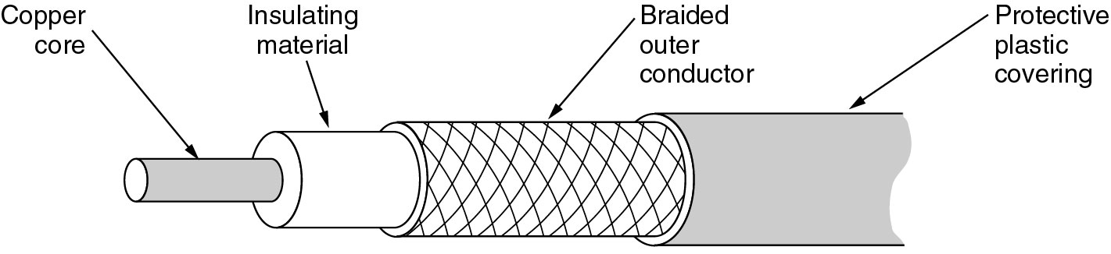
Coaxial Cable
A coaxial cable.
Prof S.A Adeshina
NILE

Slide 36
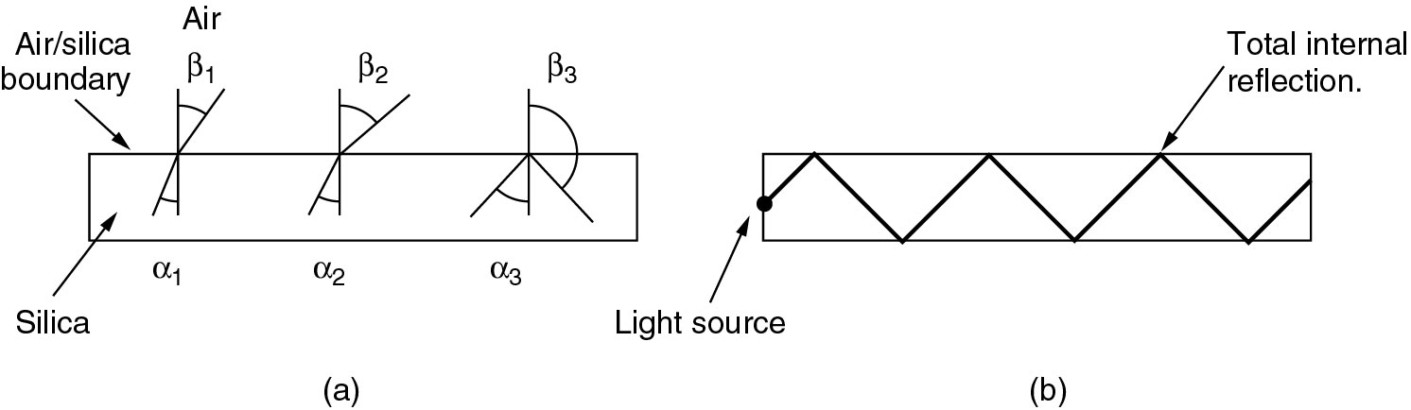
Fiber Optics
(a) Three examples of a light ray from inside a silica fiber impinging on the air/silica boundary at different angles.
(b) Light trapped by total internal reflection.
Prof S.A Adeshina
NILE

Slide 37
Coaxial Cable - Transmission Characteristics
superior frequency characteristics to TP
performance limited by attenuation & noise
analog signals
amplifiers every few km
closer if higher frequency
up to 500MHz
digital signals
repeater every 1km
closer for higher data rates
Prof S.A Adeshina
NILE
Notes:
Coaxial cable is used to transmit both analog and digital signals. It has frequency characteristics that are superior to those of twisted pair and can hence be used effectively at higher frequencies and data rates. Because of its shielded, concentric construction, coaxial cable is much less susceptible to interference and crosstalk than twisted pair. The principal constraints on performance are attenuation, thermal noise, and intermodulation noise. The latter is present only when several channels (FDM) or frequency bands are in use on the cable.
For long-distance transmission of analog signals, amplifiers are needed every few kilometers, with closer spacing required if higher frequencies are used. The usable spectrum for analog signaling extends to about 500 MHz. For digital signaling, repeaters are needed every kilometer or so, with closer spacing needed for higher data rates.

Slide 38
Optical Fiber - Benefits
greater capacity
data rates of hundreds of Gbps
smaller size & weight
lower attenuation
electromagnetic isolation
greater repeater spacing
10s of km at least
Prof S.A Adeshina
NILE
Notes:
The following characteristics distinguish optical fiber from twisted pair or coaxial cable:
• Greater capacity: The potential bandwidth, and hence data rate, of optical fiber is immense; data rates of hundreds of Gbps over tens of kilometers have been demonstrated. Compare this to the practical maximum of hundreds of Mbps over about 1 km for coaxial cable and just a few Mbps over 1 km or up to 100 Mbps to 10 Gbps over a few tens of meters for twisted pair.
• Smaller size and lighter weight: Optical fibers are considerably thinner than coaxial cable or bundled twisted-pair cable. For cramped conduits in buildings and underground along public rights-of-way, the advantage of small size is considerable. The corresponding reduction in weight reduces structural support requirements.
• Lower attenuation: Attenuation is significantly lower for optical fiber than for coaxial cable or twisted pair, and is constant over a wide range.
• Electromagnetic isolation: Optical fiber systems are not affected by external electromagnetic fields. Thus the system is not vulnerable to interference, impulse noise, or crosstalk. By the same token, fibers do not radiate energy, so there is little interference with other equipment and there is a high degree of security from eavesdropping. In addition, fiber is inherently difficult to tap.
• Greater repeater spacing: Fewer repeaters mean lower cost and fewer sources of error. The performance of optical fiber systems from this point of view has been steadily improving. Repeater spacing in the tens of kilometers for optical fiber is common, and repeater spacings of hundreds of kilometers have been demonstrated.

Slide 39
Optical Fiber - Transmission Characteristics
uses total internal reflection to transmit light
effectively acts as wave guide for 10¹⁴ to 10¹⁵ Hz
can use several different light sources
Light Emitting Diode (LED)
cheaper, wider operating temp range, lasts longer
Injection Laser Diode (ILD)
more efficient, has greater data rate
relation of wavelength, type & data rate
Prof S.A Adeshina
NILE
Notes:
Optical fiber transmits a signal-encoded beam of light by means of total internal reflection. Total internal reflection can occur in any transparent medium that has a higher index of refraction than the surrounding medium. In effect, the optical fiber acts as a waveguide for frequencies in the range of about 10¹⁴ to 10¹⁵ Hertz; this covers portions of the infrared and visible spectra.
Two different types of light source are used in fiber optic systems: the light-emitting diode (LED) and the injection laser diode (ILD). Both are semiconductor devices that emit a beam of light when a voltage is applied. The LED is less costly, operates over a greater temperature range, and has a longer operational life. The ILD, which operates on the laser principle, is more efficient and can sustain greater data rates.
There is a relationship among the wavelength employed, the type of transmission, and the achievable data rate. Both single mode and multimode can support several different wavelengths of light and can employ laser or LED light sources.

Slide 40
Optical Fiber
Prof S.A Adeshina
NILE
Notes:
An optical fiber is a thin (2 to 125 µm), flexible medium capable of guiding an optical ray. Various glasses and plastics can be used to make optical fibers. An optical fiber cable has a cylindrical shape and consists of three concentric sections: the core, the cladding, and the jacket (Stallings DCC8e Figure 4.2c). The core is the innermost section and consists of one or more very thin strands, or fibers, made of glass or plastic; the core has a diameter in the range of 8 to 50 µm. Each fiber is surrounded by its own cladding, a glass or plastic coating that has optical properties different from those of the core and a diameter of 125 µm. The interface between the core and cladding acts as a reflector to confine light that would otherwise escape the core. The outermost layer, surrounding one or a bundle of cladded fibers, is the jacket. The jacket is composed of plastic and other material layered to protect against moisture, abrasion, crushing, and other environmental dangers.
Optical fiber already enjoys considerable use in long-distance telecommunications, and its use in military applications is growing. The continuing improvements in performance and decline in prices, together with the inherent advantages of optical fiber, have made it increasingly attractive for local area networking. Five basic categories of application have become important for optical fiber: Long-haul trunks, Metropolitan trunks, Rural exchange trunks, Subscriber loops & Local area networks.

Slide 41
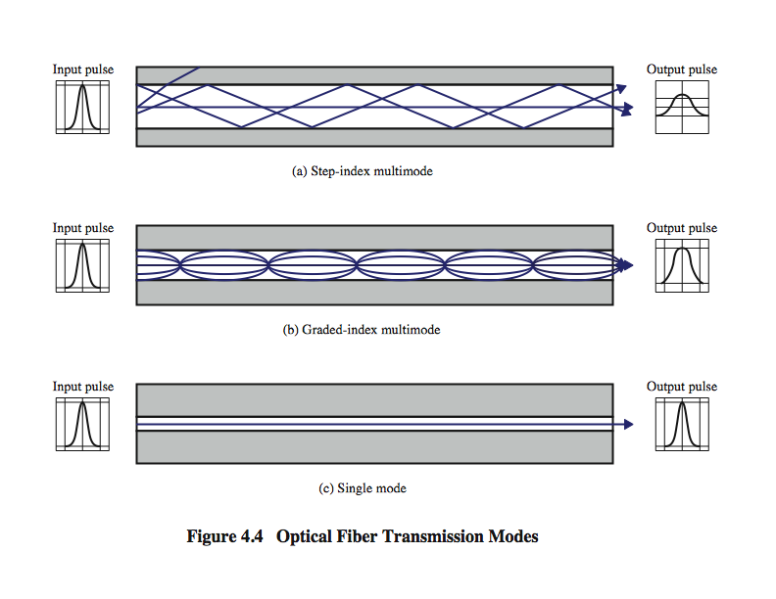
Optical Fiber Transmission Modes
Prof S.A Adeshina
NILE
Notes:
Stallings DCC8e Figure 4.4 shows the principle of optical fiber transmission. Light from a source enters the cylindrical glass or plastic core. Rays at shallow angles are reflected and propagated along the fiber; other rays are absorbed by the surrounding material. This form of propagation is called step-index multimode, referring to the variety of angles that will reflect. With multimode transmission, multiple propagation paths exist, each with a different path length and hence time to traverse the fiber. This causes signal elements (light pulses) to spread out in time, which limits the rate at which data can be accurately received. This type of fiber is best suited for transmission over very short distances.
When the fiber core radius is reduced, fewer angles will reflect. By reducing the radius of the core to the order of a wavelength, only a single angle or mode can pass: the axial ray. This single-mode propagation provides superior performance for the following reason. Because there is a single transmission path with single-mode transmission, the distortion found in multimode cannot occur. Single-mode is typically used for long-distance applications, including telephone and cable television.
Finally, by varying the index of refraction of the core, a third type of transmission, known as graded-index multimode, is possible. The higher refractive index (discussed subsequently) at the center makes the light rays moving down the axis advance more slowly than those near the cladding. Rather than zig-zagging off the cladding, light in the core curves helically because of the graded index, reducing its travel distance. The shortened path and higher speed allows light at the periphery to arrive at a receiver at about the same time as the straight rays in the core axis. Graded-index fibers are often used in local area networks.

Slide 42
Frequency Utilization for Fiber Applications
Prof S.A Adeshina
NILE
Notes:
In optical fiber, based on the attenuation characteristics of the medium and on properties of light sources and receivers, four transmission windows are appropriate, as shown in Stallings DCC8e Table 4.5. Note the tremendous bandwidths available. For the four windows, the respective bandwidths are 33 THz, 12 THz, 4 THz, and 7 THz. This is several orders of magnitude greater than the bandwidth available in the radio-frequency spectrum.
The four transmission windows are in the infrared portion of the frequency spectrum, below the visible-light portion, which is 400 to 700 nm. The loss is lower at higher wavelengths, allowing greater data rates over longer distances. Many local applications today use 850-nm LED light sources. Although this combination is relatively inexpensive, it is generally limited to data rates under 100 Mbps and distances of a few kilometers. To achieve higher data rates and longer distances, a 1300-nm LED or laser source is needed. The highest data rates and longest distances require 1500-nm laser sources. nb. WDM = wavelength division multiplexing (see Chapter 8).

Slide 43
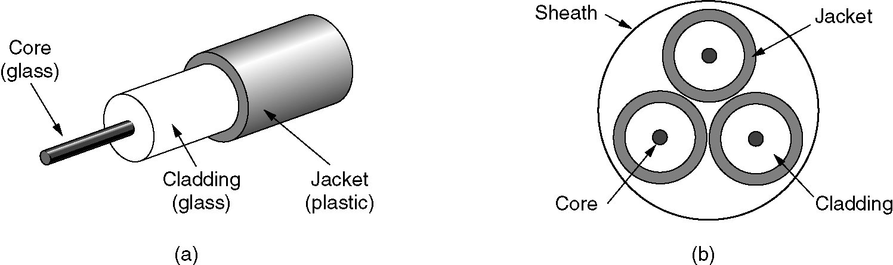
Fiber Cables
(a) Side view of a single fiber.
(b) End view of a sheath with three fibers.
Prof S.A Adeshina
NILE

Slide 44
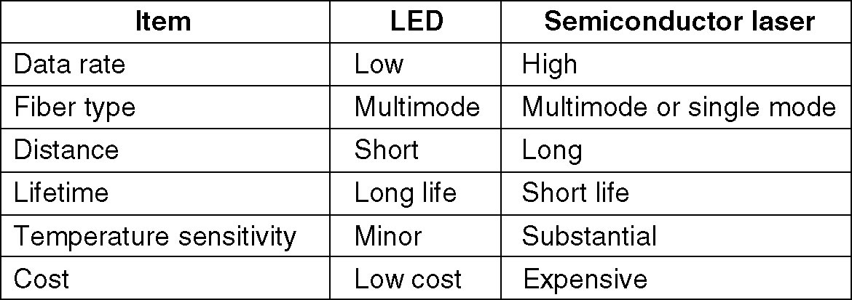
Fiber Cables (2)
A comparison of semiconductor diodes and LEDs as light sources.
Prof S.A Adeshina
NILE

Slide 45
Wireless Transmission
The Electromagnetic Spectrum
Radio Transmission
Microwave Transmission
Infrared and Millimeter Waves
Lightwave Transmission
Prof S.A Adeshina
NILE

Slide 46
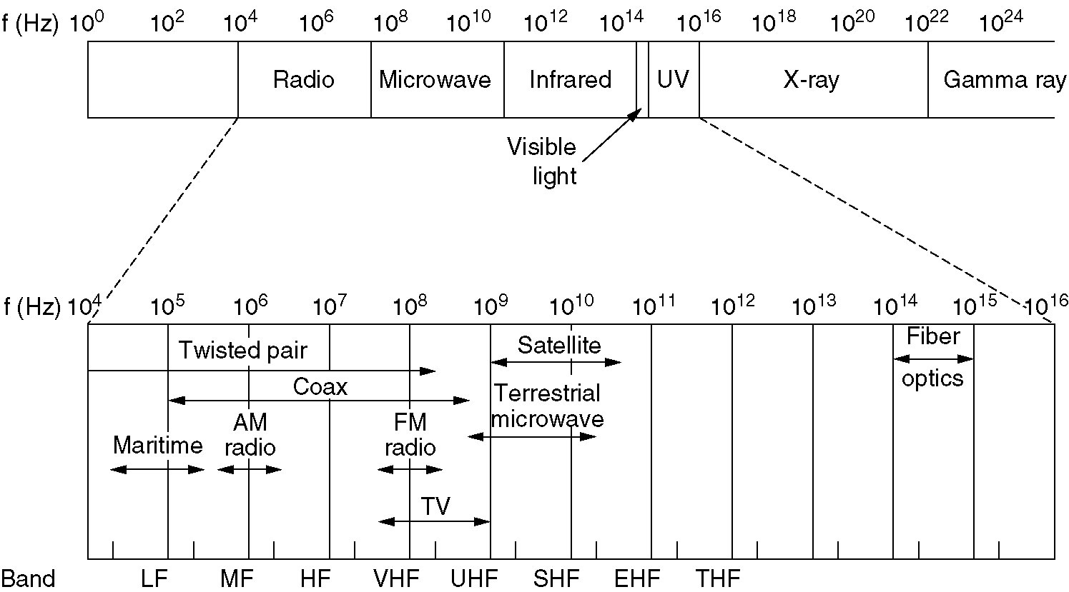
The Electromagnetic Spectrum
The electromagnetic spectrum and its uses for communication.
Prof S.A Adeshina
NILE
Notes:
THF – Means Tremendously High Frequency

Slide 47
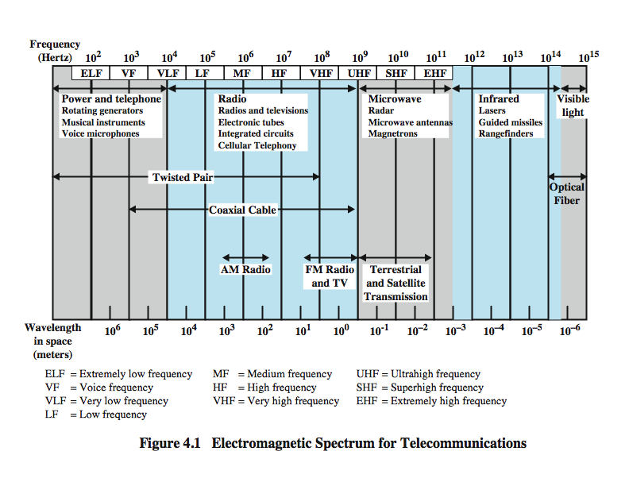
Electromagnetic Spectrum
Prof S.A Adeshina
NILE
Notes:
Figure 4.1 depicts the electromagnetic spectrum and indicates the frequencies at which various guided media and unguided transmission techniques operate. In this chapter we examine these guided and unguided alternatives. In all cases, we describe the systems physically, briefly discuss applications, and summarize key transmission characteristics.

Slide 48
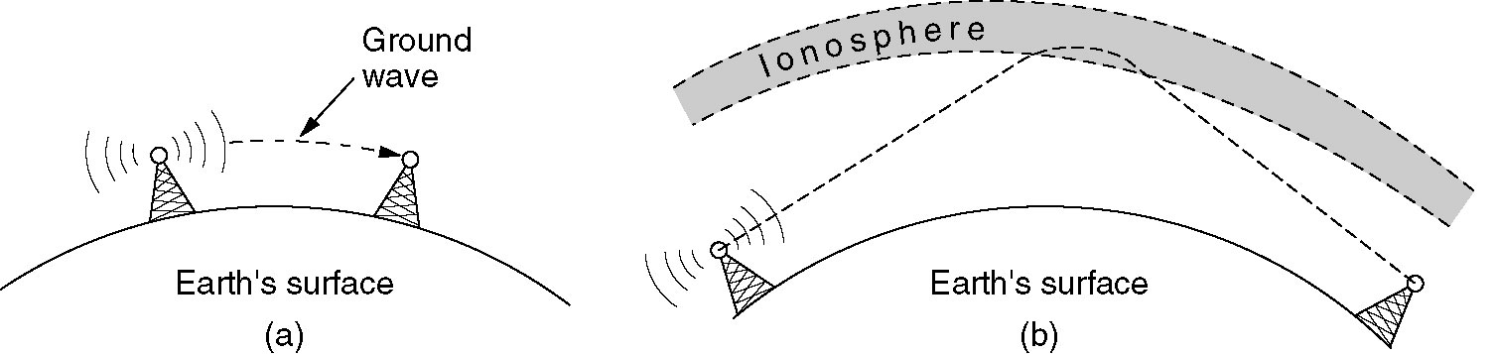
Radio Transmission
(a) In the VLF, LF, and MF bands, radio waves follow the curvature of the earth.
(b) In the HF band, they bounce off the ionosphere.
Prof S.A Adeshina
NILE

Slide 49
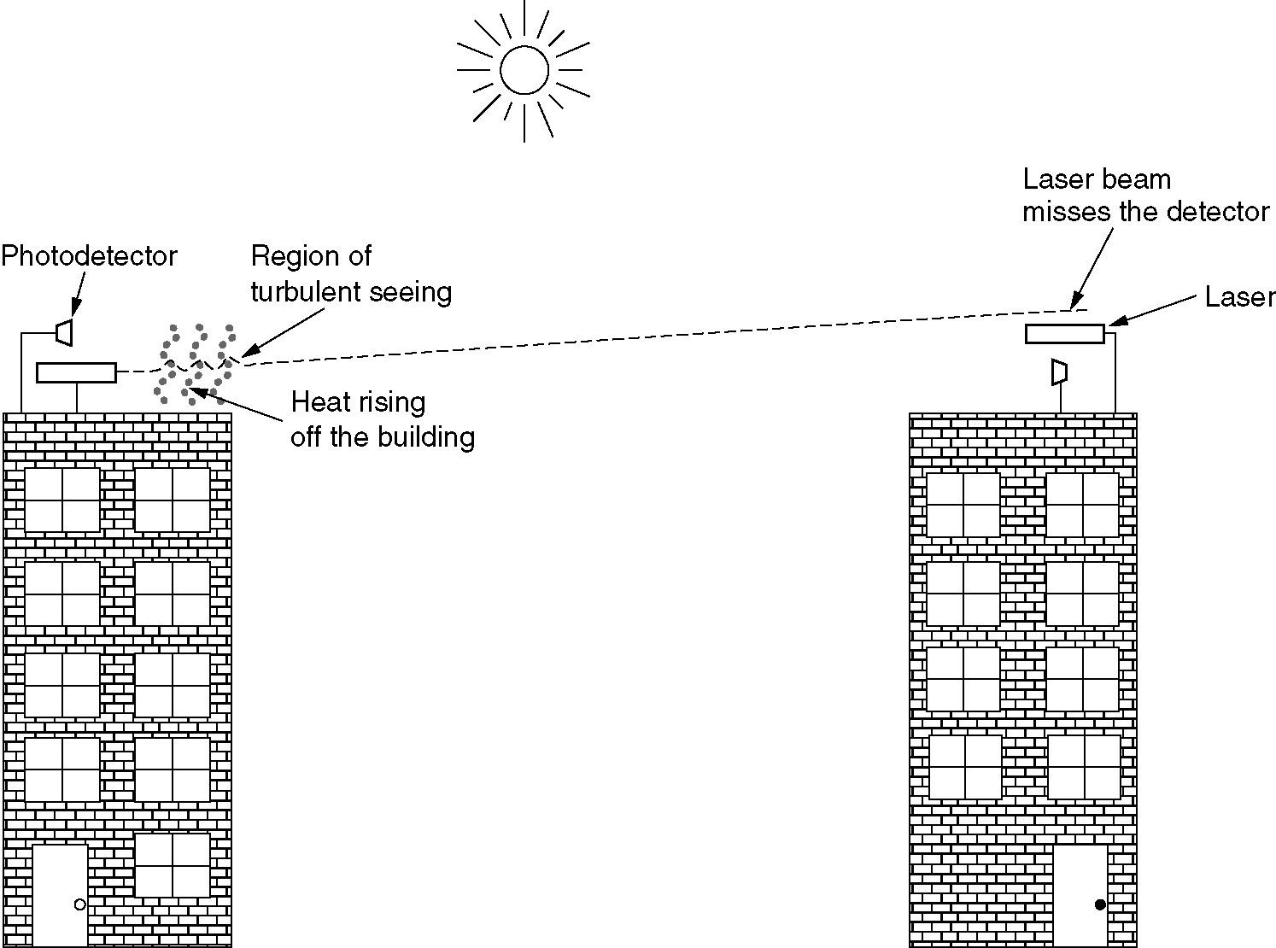
Lightwave Transmission
Convection currents can interfere with laser communication systems.
A bidirectional system with two lasers is pictured here.
Prof S.A Adeshina
NILE

Slide 50
Communication Satellites
Geostationary Satellites
Medium-Earth Orbit Satellites
Low-Earth Orbit Satellites
Satellites versus Fiber
Prof S.A Adeshina
NILE
Notes:
Stopped here for MSc NITDA 2021

Slide 51
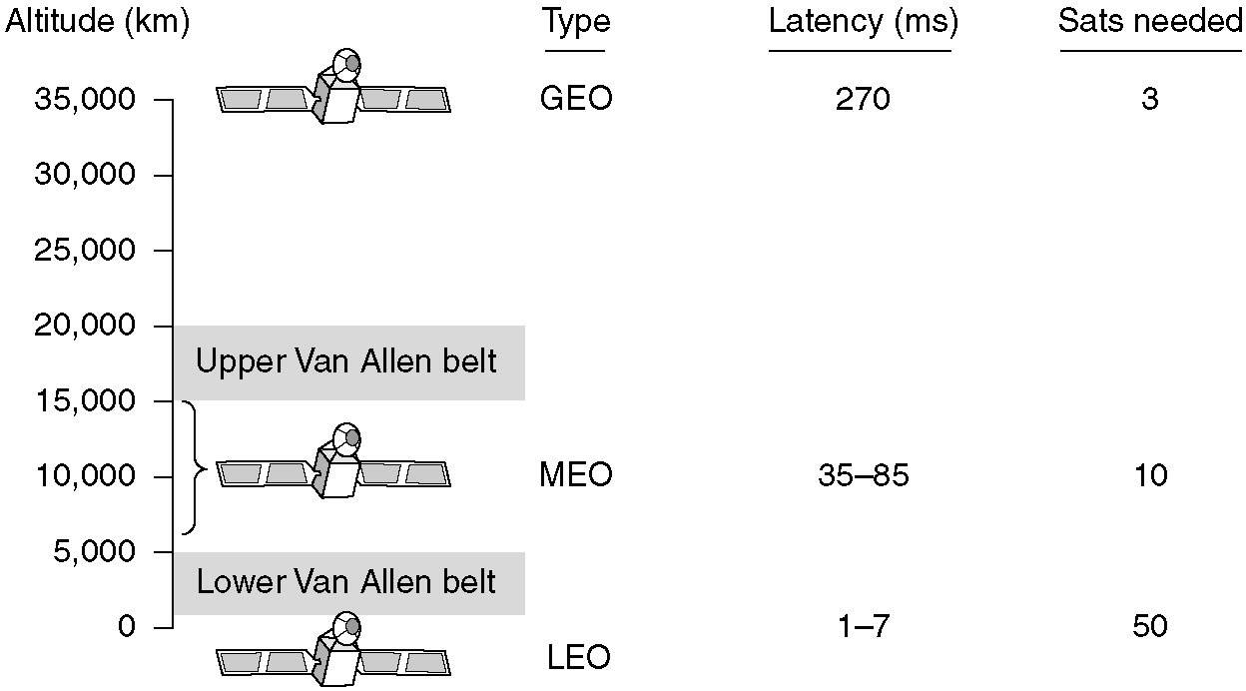
Communication Satellites
Communication satellites and some of their properties, including altitude above the earth, round-trip delay time and number of satellites needed for global coverage.
Prof S.A Adeshina
NILE

Slide 52
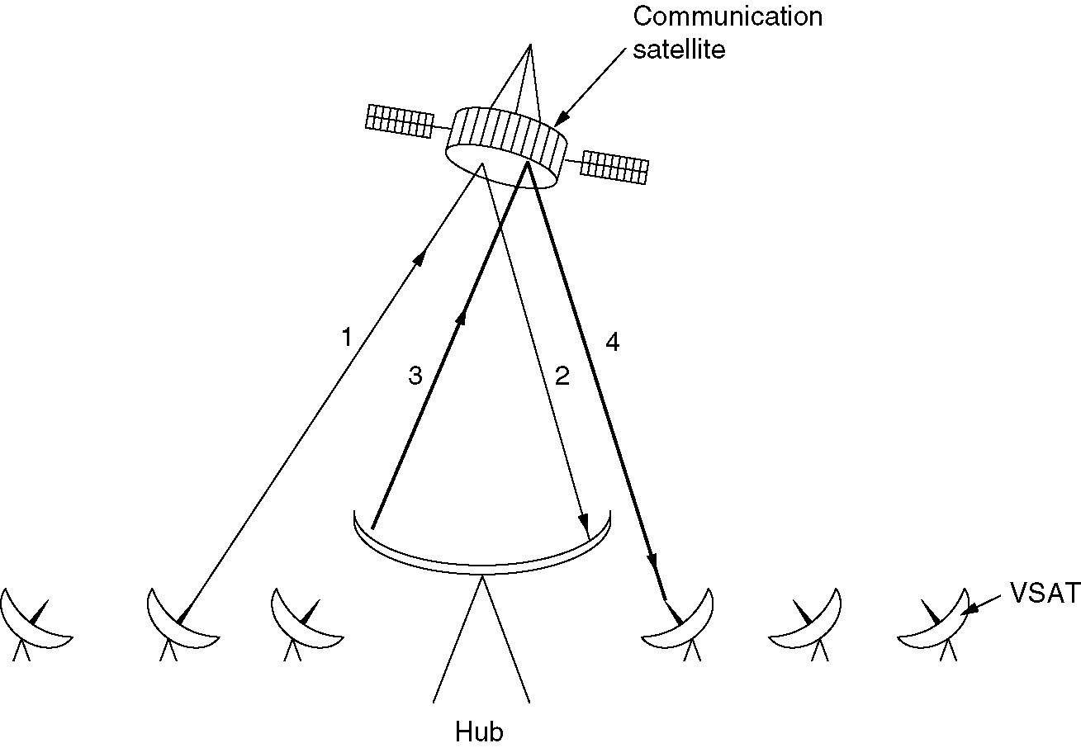
Communication Satellites (3)
VSATs using a hub.
Prof S.A Adeshina
NILE

Slide 53
Low-Earth Orbit Satellites Iridium
(a) The Iridium satellites from six necklaces around the earth.
(b) 1628 moving cells cover the earth.
Prof S.A Adeshina
NILE

Slide 54
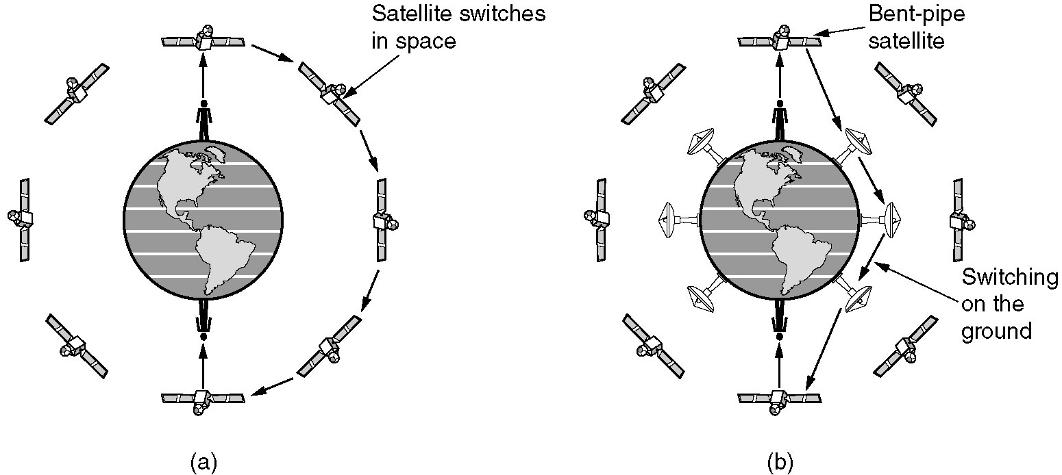
Globalstar
(a) Relaying in space.
(b) Relaying on the ground.
Prof S.A Adeshina
NILE
Notes:
Stopped here for Regular masters 5pm class – 21/10/2019
Globalstar is a low Earth orbit (LEO) satellite constellation for satellite phone and low-speed data communications, somewhat similar to the Iridium satellite constellation and Orbcomm satellite systems.

Slide 55
Public Switched Telephone System
Structure of the Telephone System
The Politics of Telephones
The Local Loop: Modems, ADSL and Wireless
Trunks and Multiplexing
Switching
Dr S.A Adeshina
NTNU

Slide 56
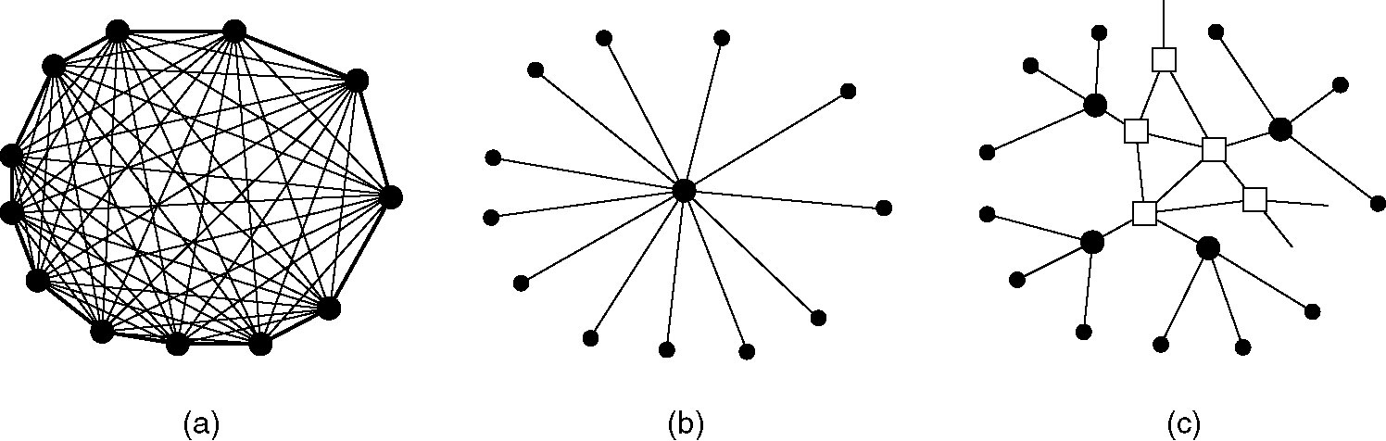
Structure of the Telephone System
(a) Fully-interconnected network.
(b) Centralized switch.
(c) Two-level hierarchy.
Prof S.A Adeshina
NILE

Slide 57
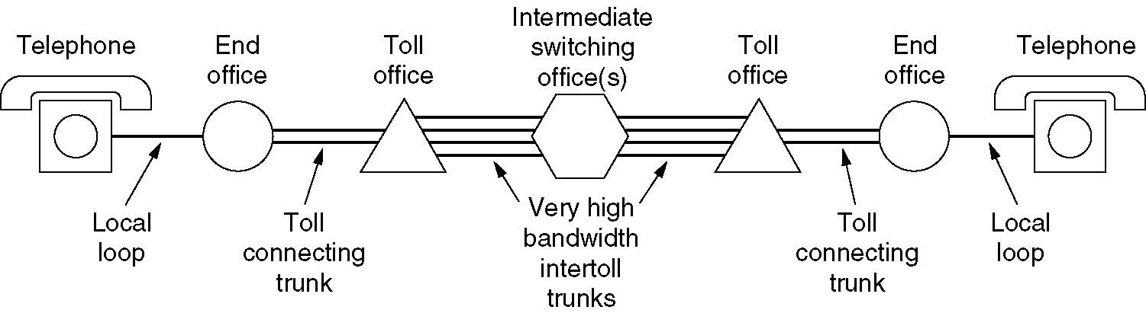
Structure of the Telephone System (2)
A typical circuit route for a medium-distance call.
Prof S.A Adeshina
NILE

Slide 58
Major Components of the Telephone System
Local loops
Analog twisted pairs going to houses and businesses
Trunks
Digital fiber optics connecting the switching offices
Switching offices
Where calls are moved from one trunk to another
Prof S.A Adeshina
NILE

Slide 59
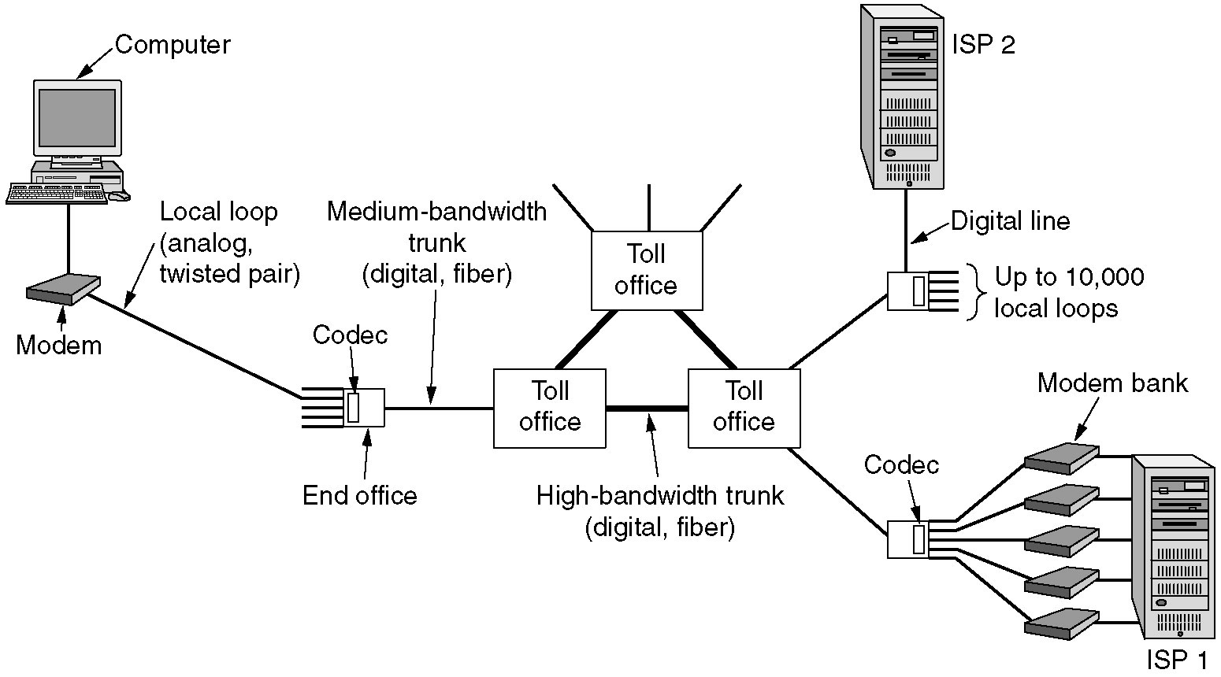
The Local Loop: Modems, ADSL, and Wireless
The use of both analog and digital transmissions for a computer to computer call. Conversion is done by the modems and codecs.
Prof S.A Adeshina
NILE

Slide 60
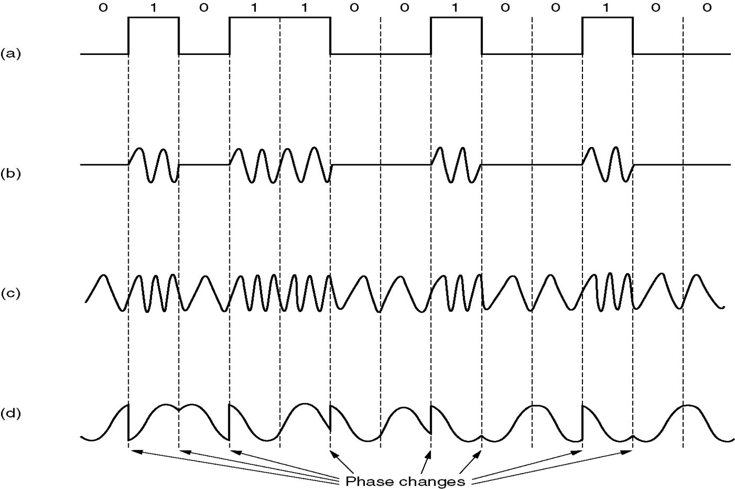
Modems
(a) A binary signal
(b) Amplitude modulation
(c) Frequency modulation
(d) Phase modulation
Prof S.A Adeshina
NILE

Slide 61
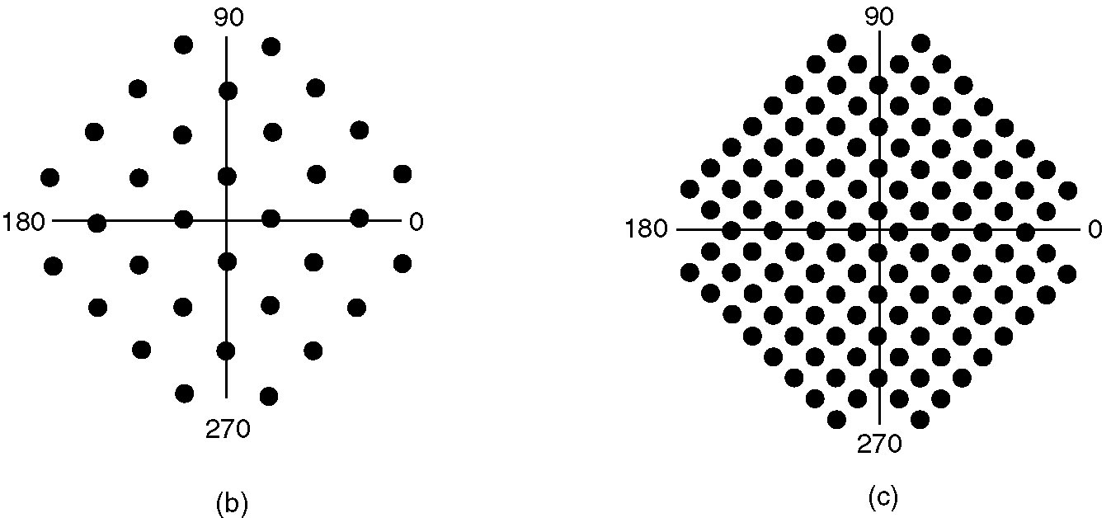
Modems (3)
(a)
(b)
(a) V.32 for 9600 bps.
(b) V32 bis for 14,400 bps.
Prof S.A Adeshina
NILE

Slide 62
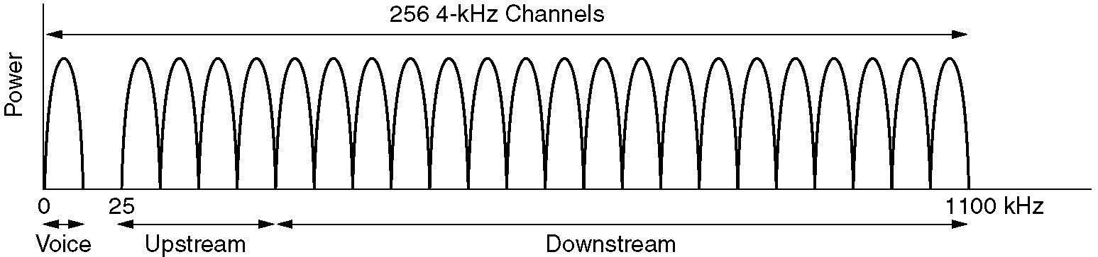
Digital Subscriber Lines (2)
Operation of ADSL using discrete multitone modulation.
Prof S.A Adeshina
NILE

Slide 63
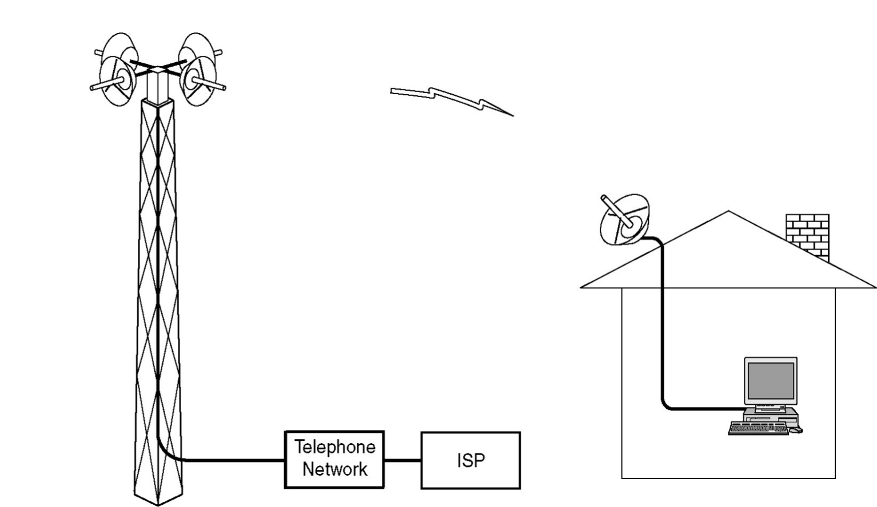
Wireless Local Loops
Architecture of an LMDS system.
Prof S.A Adeshina
NILE
Notes:
Local multipoint distribution service (LMDS) is a broadband wireless access technology for provision of point-to-multipoint communication via microwaves. Originally conceived in the late 1990s, LMDS was designed for digital TV transmission.

Slide 64
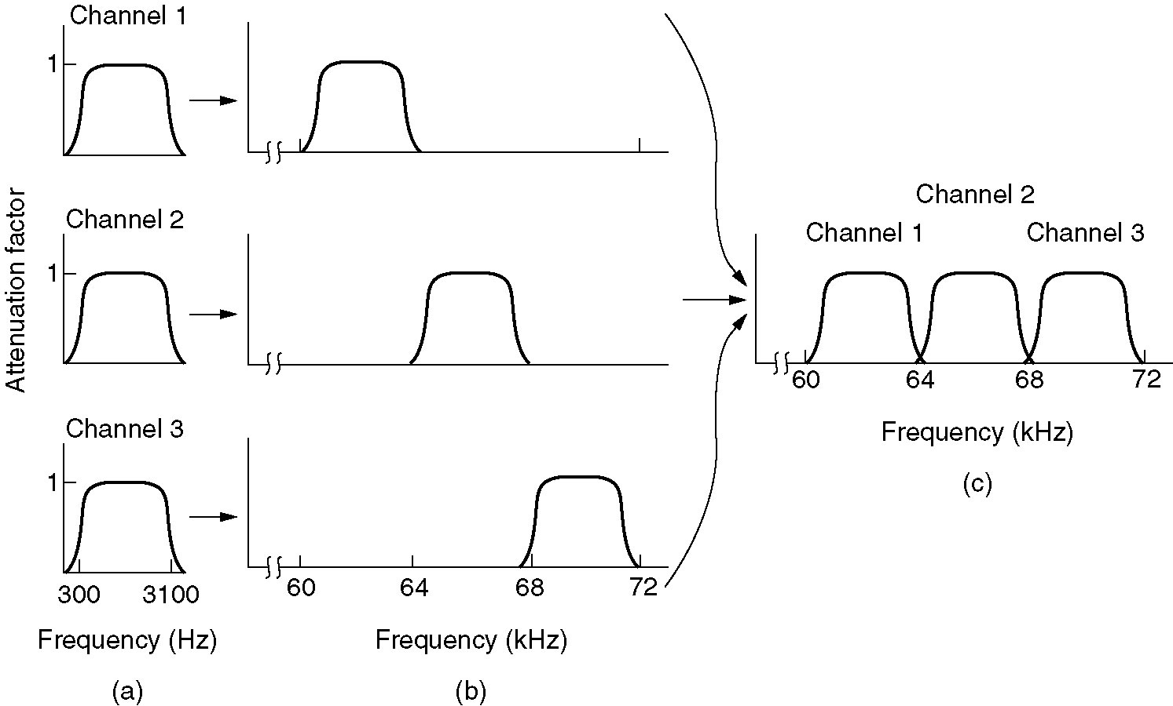
Frequency Division Multiplexing
(a) The original bandwidths.
(b) The bandwidths raised in frequency.
(b) The multiplexed channel.
Prof S.A Adeshina
NILE

Slide 65
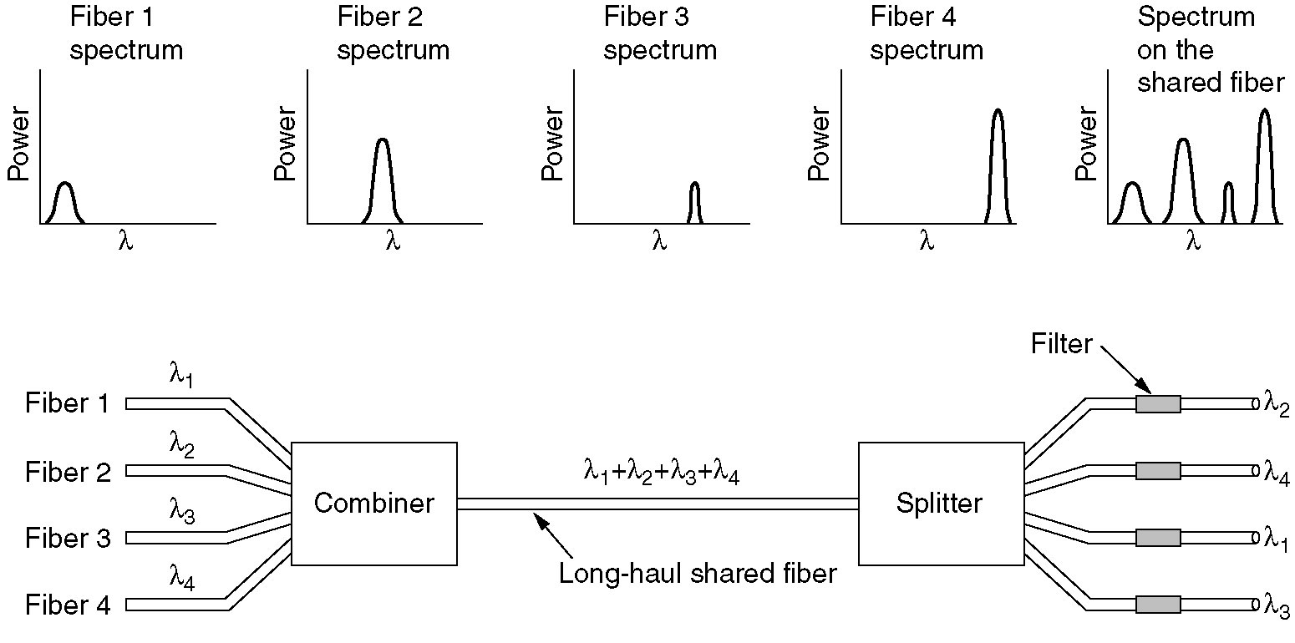
Wavelength Division Multiplexing
Wavelength division multiplexing.
Prof S.A Adeshina
NILE

Slide 66
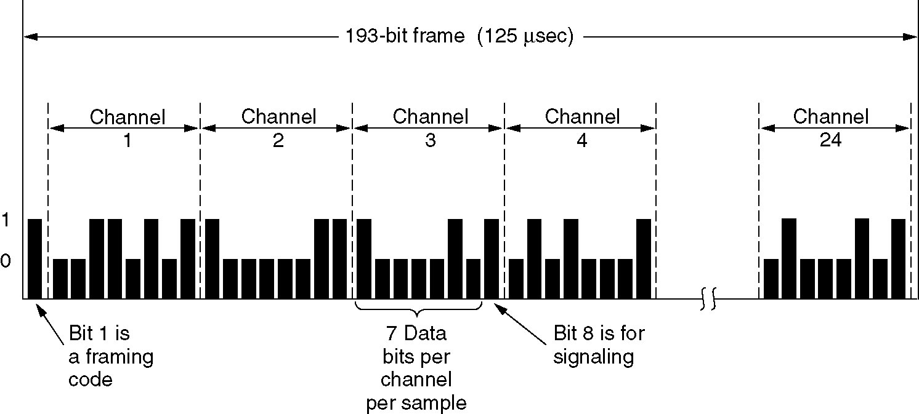
Time Division Multiplexing
The T1 carrier (1.544 Mbps).
Prof S.A Adeshina
NILE
Notes:
Time-division multiplexing (TDM) is a method of putting multiple data streams in a single signal by separating the signal into many segments, each having a very short duration. Each individual data stream is reassembled at the receiving end based on the timing.

Slide 67
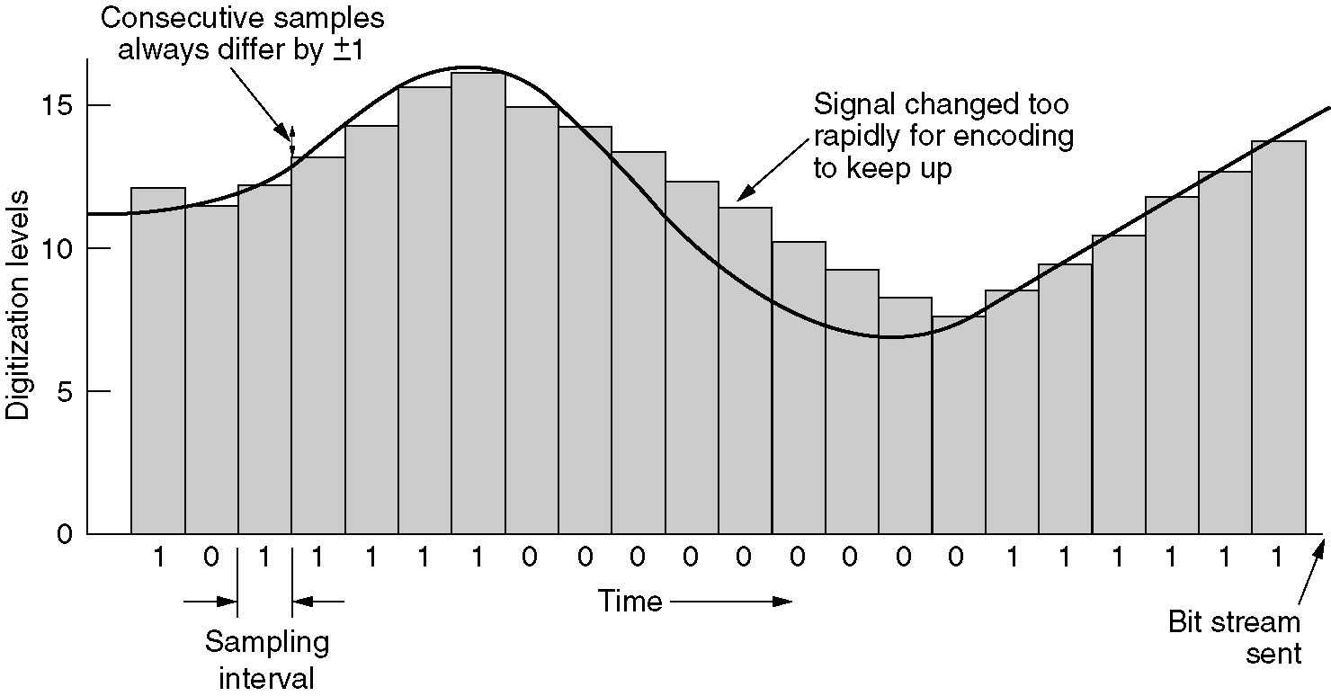
Time Division Multiplexing (2)
Delta modulation.
Prof S.A Adeshina
NILE

Slide 68
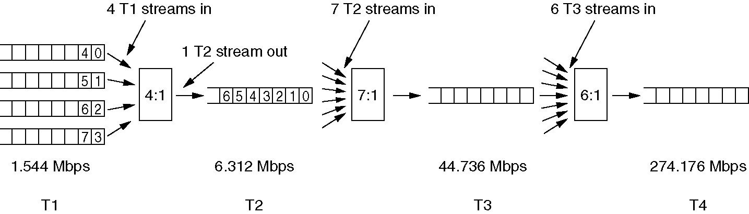
Time Division Multiplexing (3)
Multiplexing T1 streams into higher carriers.
Prof S.A Adeshina
NILE

Slide 69
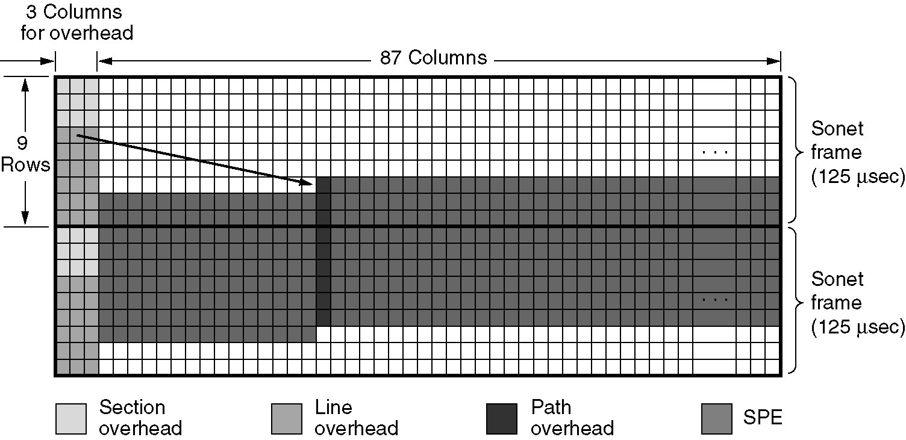
Time Division Multiplexing (4)
Two back-to-back SONET frames.
Prof S.A Adeshina
NILE

Slide 70
Circuit Switching
uses a dedicated communications path established for duration of conversation
comprising a sequence of physical links
with a dedicated logical channel
eg. telephone network
Prof S.A Adeshina
NILE
Notes:
In a circuit-switching network, a dedicated communications path is established between two stations through the nodes of the network. That path is a connected sequence of physical links between nodes, with a logical channel dedicated to the connection. Data generated by the source station are transmitted along the dedicated path as rapidly as possible. The most common example of circuit switching is the telephone network.

Slide 71
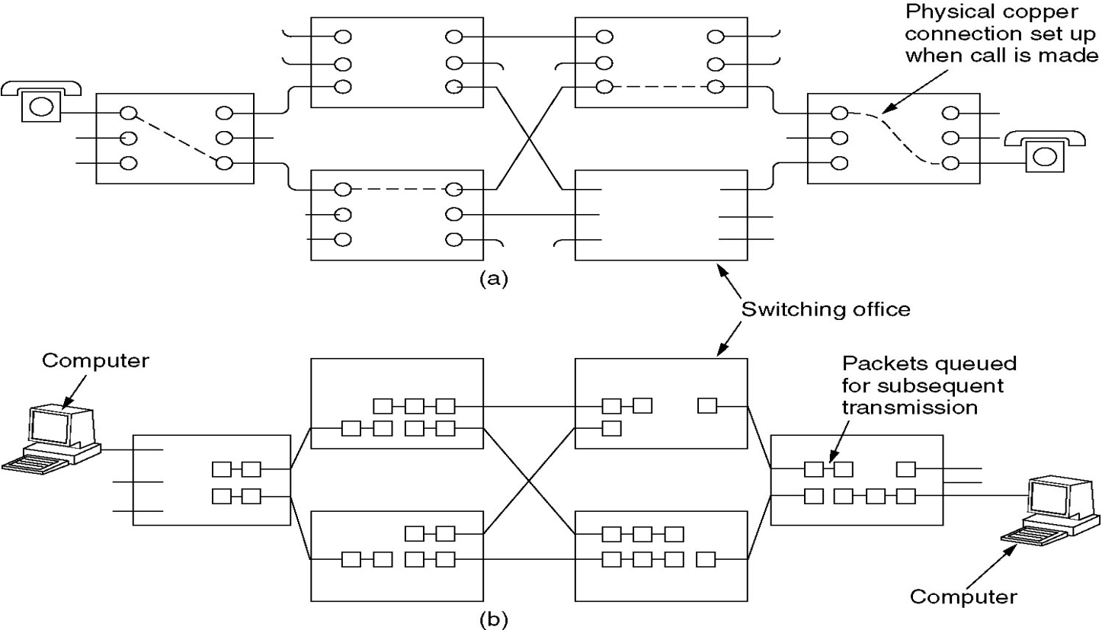
Circuit Switching
(a) Circuit switching.
(b) Packet switching.
Prof S.A Adeshina
NILE

Slide 72
Packet Switching
data sent out of sequence
small chunks (packets) of data at a time
packets passed from node to node between source and destination
used for terminal to computer and computer to computer communications
Prof S.A Adeshina
NILE
Notes:
A packet-switching network uses a quite different approach, without need to dedicate transmission capacity along a path through the network. Rather, data is sent in a sequence of small chunks, called packets. Each packet is passed through the network from node to node along some path leading from source to destination. At each node, the entire packet is received, stored briefly, and then transmitted to the next node. Packet-switching networks are commonly used for terminal-to-computer and computer-to-computer communications.

Slide 73
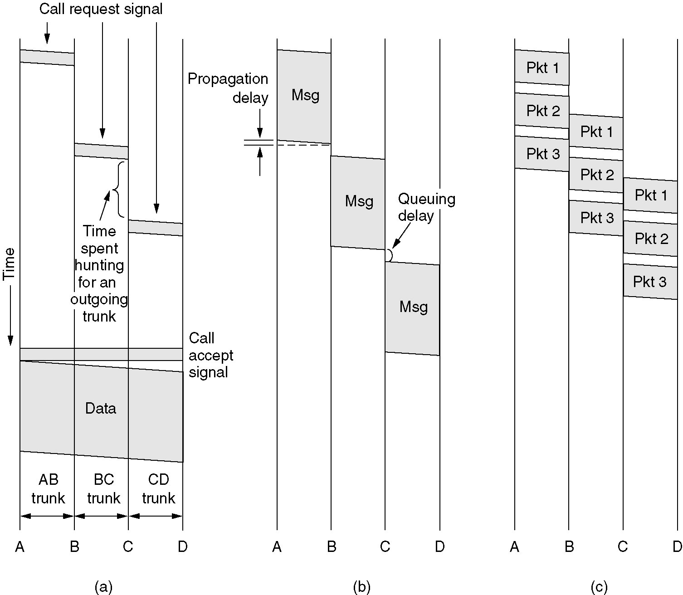
Message Switching
Prof S.A Adeshina
NILE
(a) Circuit switching (b) Message switching (c) Packet switching

Slide 74
Frame Relay
packet switching systems have large overheads to compensate for errors
modern systems are more reliable
errors can be caught in end system
Frame Relay provides higher speeds
with most error control overhead removed
Prof S.A Adeshina
NILE
Notes:
Frame relay was developed to take advantage of high data rates and low error rates on modern WAN links. Whereas the original packet-switching networks were designed with a data rate to the end user of about 64 kbps, frame relay networks are designed to operate efficiently at user data rates of up to 2 Mbps. The key to achieving these high data rates is to strip out most of the overhead involved with error control.

Slide 75
Asynchronous Transfer Mode
ATM
evolution of frame relay
fixed packet (called cell) length
with little overhead for error control
anything from 10Mbps to Gbps
constant data rate using packet switching technique with multiple virtual circuits
Prof S.A Adeshina
NILE
Notes:
Asynchronous transfer mode (ATM), is a culmination of developments in circuit switching and packet switching. ATM can be viewed as an evolution from frame relay. ATM uses fixed-length packets, called cells. As with frame relay, ATM provides little overhead for error control, depending on the inherent reliability of the transmission system and on higher layers of logic in the end systems to catch and correct errors. By using a fixed packet length, the processing overhead is reduced even further for ATM compared to frame relay. The result is that ATM is designed to work in the range of 10s and 100s of Mbps, and in the Gbps range. ATM allows the definition of multiple virtual channels with data rates that are dynamically defined at the time the virtual channel is created.

Slide 76
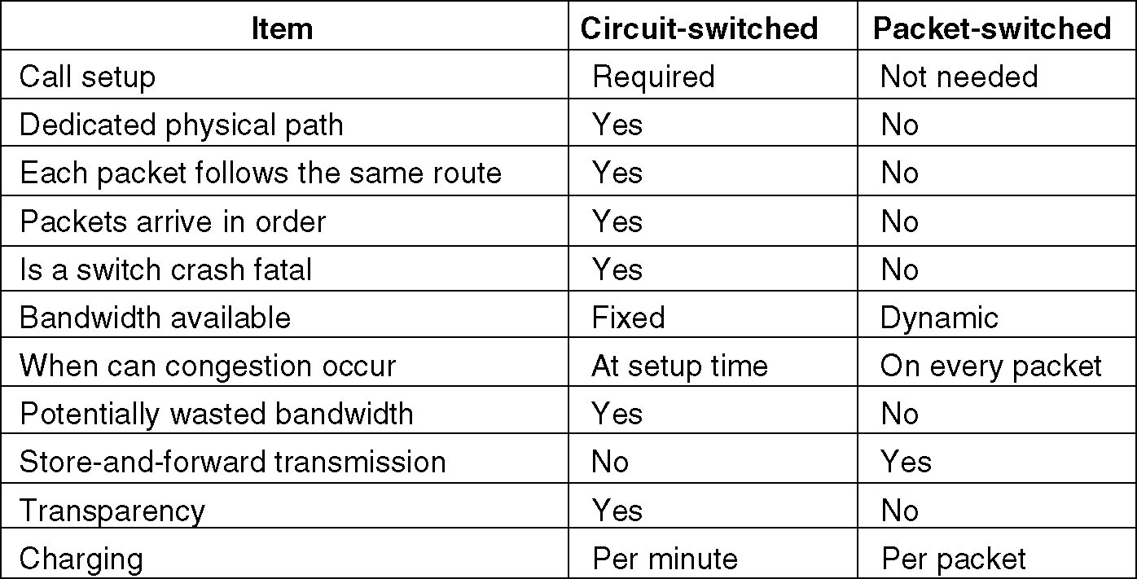
Packet Switching
Prof S.A Adeshina
NILE
A comparison of circuit switched and packet-switched networks.

Slide 77
The Mobile Telephone System
First-Generation Mobile Phones: Analog Voice
Second-Generation Mobile Phones: Digital Voice
Third-Generation Mobile Phones: Digital Voice and Data
Prof S.A Adeshina
NILE

Slide 78
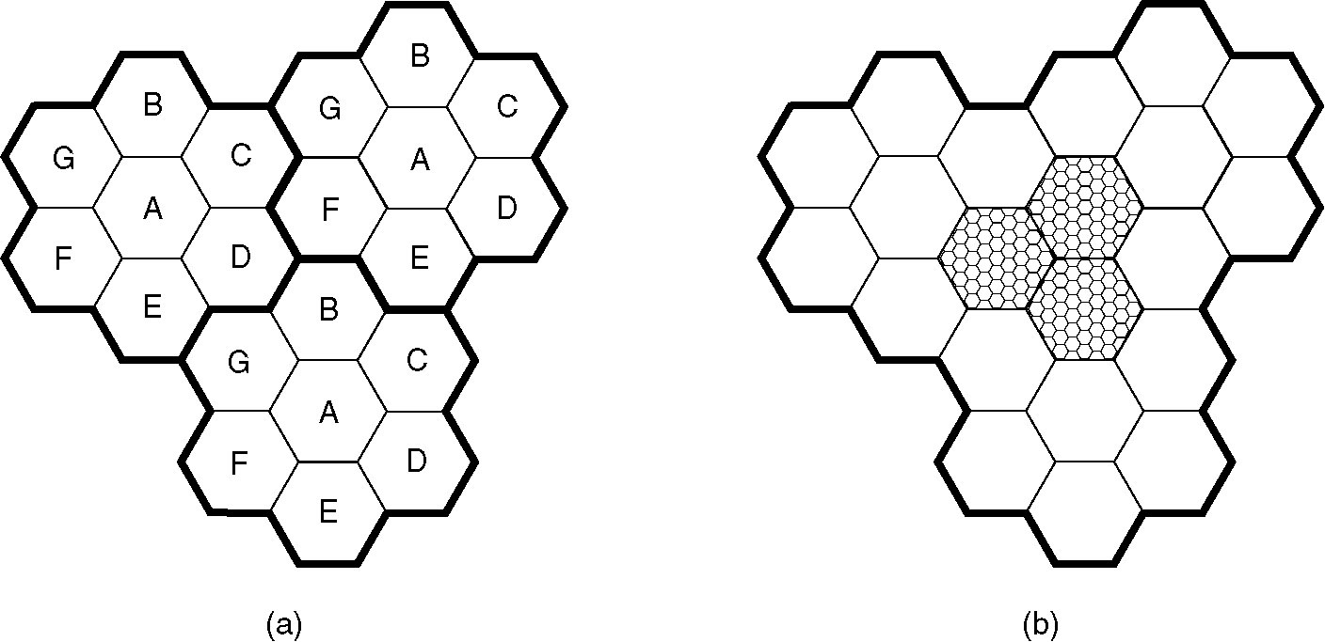
Advanced Mobile Phone System
(a) Frequencies are not reused in adjacent cells.
(b) To add more users, smaller cells can be used.
Prof S.A Adeshina
NILE

Slide 79
Channel Categories
The 832 channels are divided into four categories:
Control (base to mobile) to manage the system
Paging (base to mobile) to alert users to calls for them
Access (bidirectional) for call setup and channel assignment
Data (bidirectional) for voice, fax, or data
Prof S.A Adeshina
NILE

Slide 80
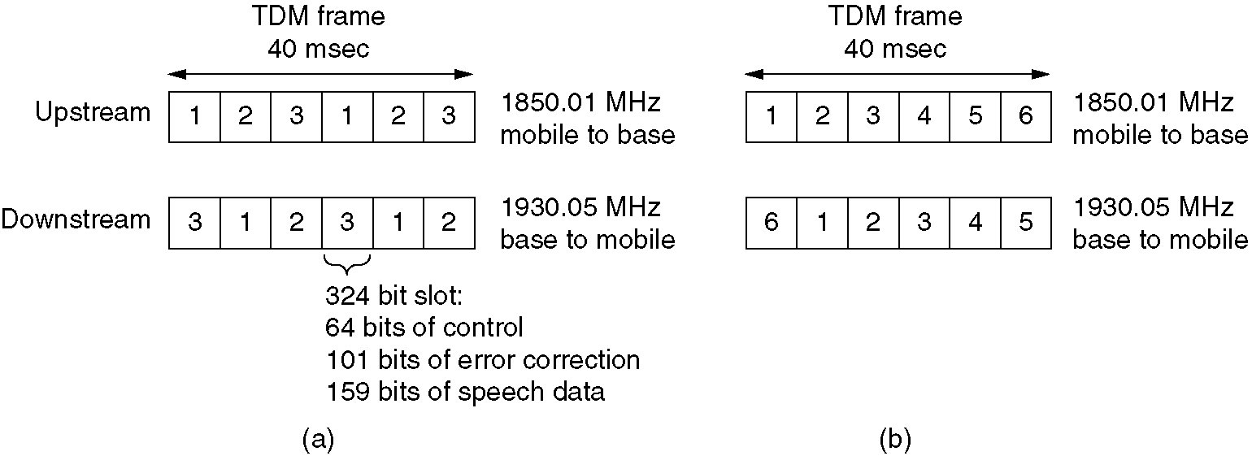
D-AMPS Digital Advanced Mobile Phone System
(a) A D-AMPS channel with three users.
(b) A D-AMPS channel with six users.
Prof S.A Adeshina
NILE

Slide 81
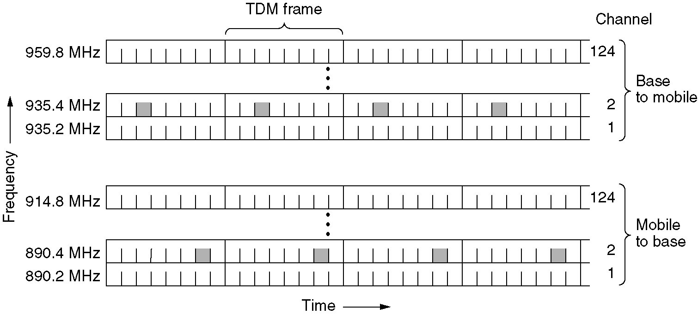
GSM Global System for Mobile Communications
GSM uses 124 frequency channels, each of which uses an eight-slot TDM system
Prof S.A Adeshina
NILE

Slide 82
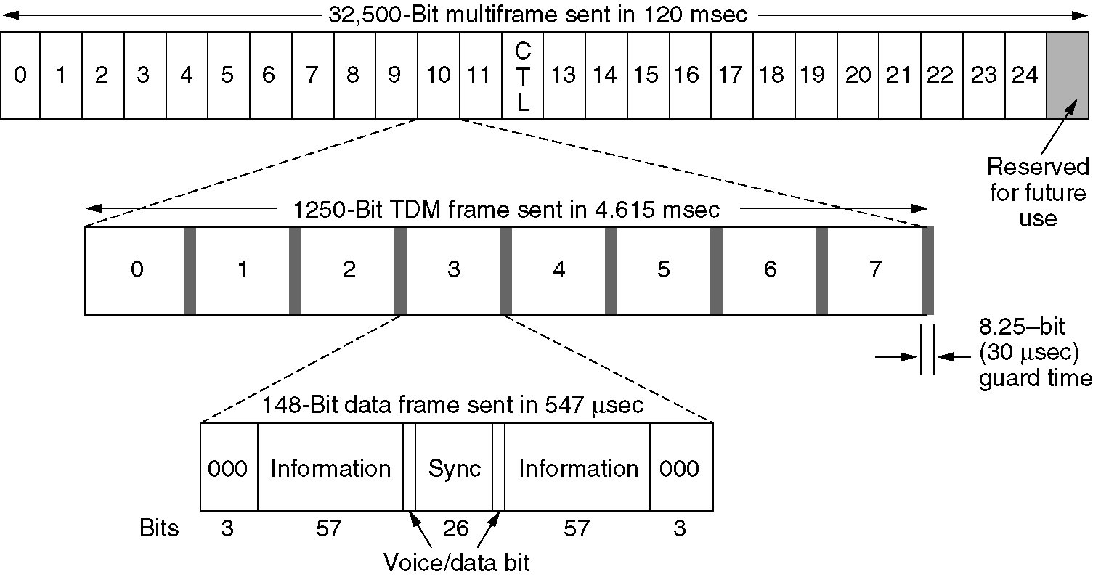
GSM (2)
A portion of the GSM framing structure.
Prof S.A Adeshina
NILE

Slide 83
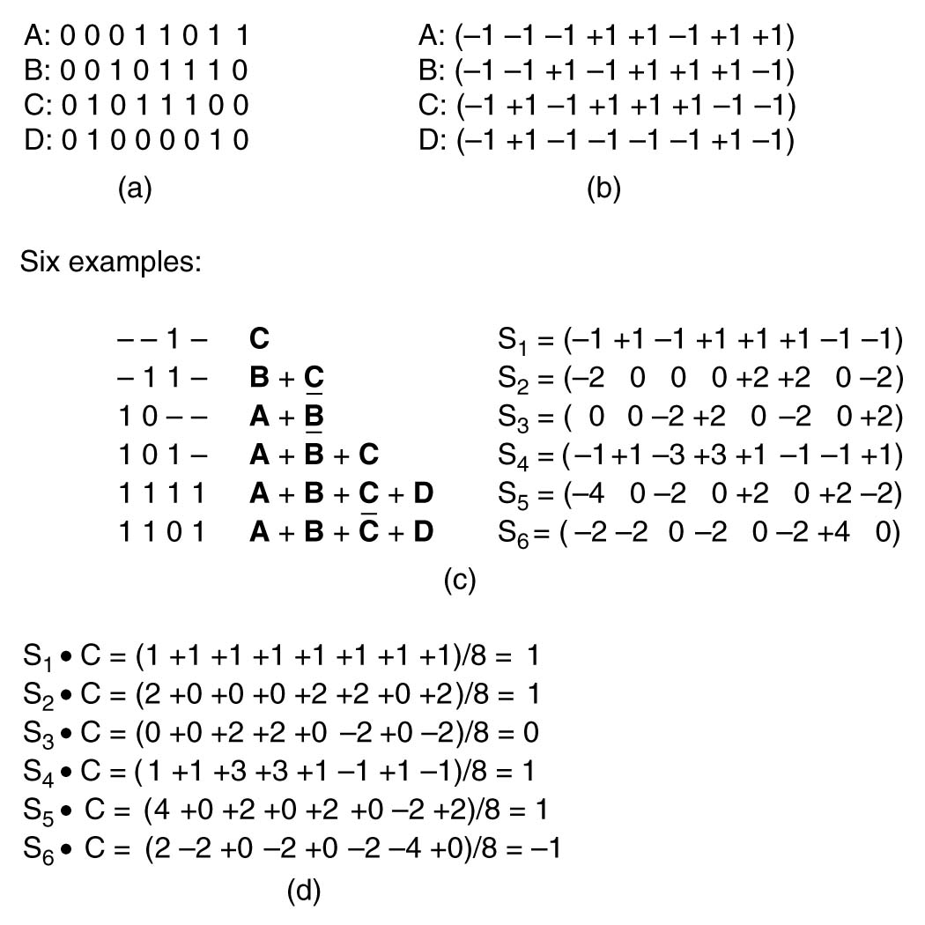
CDMA – Code Division Multiple Access
(a) Binary chip sequences for four stations
(b) Bipolar chip sequences
(c) Six examples of transmissions
(d) Recovery of station C’s signal
Prof S.A Adeshina
NILE

Slide 84
Third-Generation Mobile Phones: Digital Voice and Data
Basic services an IMT-2000 network should provide
High-quality voice transmission
Messaging (replace e-mail, fax, SMS, chat, etc.)
Multimedia (music, videos, films, TV, etc.)
Internet access (web surfing, w/multimedia.)
Prof S.A Adeshina
NILE

Slide 85
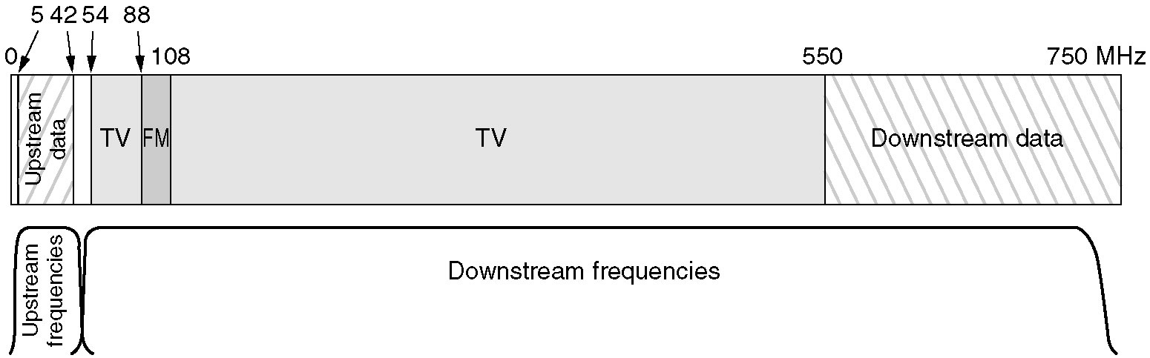
Spectrum Allocation
Frequency allocation in a typical cable TV system used for Internet access
Prof S.A Adeshina
NILE

Slide 86
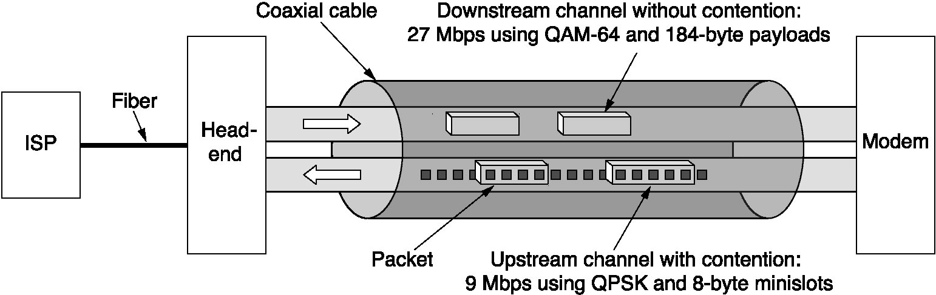
Cable Modems
Typical details of the upstream and downstream channels in North America.
Prof S.A Adeshina
NILE

Slide 87
Wireless Transmission Frequencies
2GHz to 40GHz
microwave
highly directional
point to point
satellite
30MHz to 1GHz
omnidirectional
broadcast radio
3 x 10¹¹ to 2 x 10¹⁴
infrared
local
Prof S.A Adeshina
NILE
Notes:
Unguided transmission techniques commonly used for information communications include broadcast radio, terrestrial microwave, and satellite. Infrared transmission is used in some LAN applications. Three general ranges of frequencies are of interest in our discussion of wireless transmission.
Frequencies in the range of about 1 to 40 GHz are referred to as microwave frequencies. At these frequencies, highly directional beams are possible, and microwave is quite suitable for point-to-point transmission. Microwave is also used for satellite communications.
Frequencies in the range of 30 MHz to 1 GHz are suitable for omnidirectional applications. We refer to this range as the radio range.
Another important frequency range is the infrared portion of the spectrum, roughly from 3 × 10¹¹ to 2 × 10¹⁴ Hz. Infrared is useful to local point-to-point and multipoint applications within confined areas, such as a single room.

Slide 88
Antennas
electrical conductor used to radiate or collect electromagnetic energy
transmission antenna
radio frequency energy from transmitter
converted to electromagnetic energy byy antenna
radiated into surrounding environment
reception antenna
electromagnetic energy impinging on antenna
converted to radio frequency electrical energy
fed to receiver
same antenna is often used for both purposes
Prof S.A Adeshina
NILE
Notes:
For unguided media, transmission and reception are achieved by means of an antenna. An antenna can be defined as an electrical conductor or system of conductors used either for radiating electromagnetic energy or for collecting electromagnetic energy.
For transmission of a signal, radio-frequency electrical energy from the transmitter is converted into electromagnetic energy by the antenna and radiated into the surrounding environment.
For reception of a signal, electromagnetic energy impinging on the antenna is converted into radio-frequency electrical energy and fed into the receiver.
In two-way communication, the same antenna can be and often is used for both transmission and reception. This is possible because antenna characteristics are essentially the same whether an antenna is sending or receiving electromagnetic energy.

Slide 89
Radiation Pattern
power radiated in all directions
not same performance in all directions
as seen in a radiation pattern diagram
an isotropic antenna is a (theoretical) point in space
radiates in all directions equally
with a spherical radiation pattern
Prof S.A Adeshina
NILE
Notes:
An antenna will radiate power in all directions but, typically, does not perform equally well in all directions. A common way to characterize the performance of an antenna is the radiation pattern, which is a graphical representation of the radiation properties of an antenna as a function of space coordinates.
The simplest pattern is produced by an idealized antenna known as the isotropic antenna. An isotropic antenna is a point in space that radiates power in all directions equally. The actual radiation pattern for the isotropic antenna is a sphere with the antenna at the center.

Slide 90
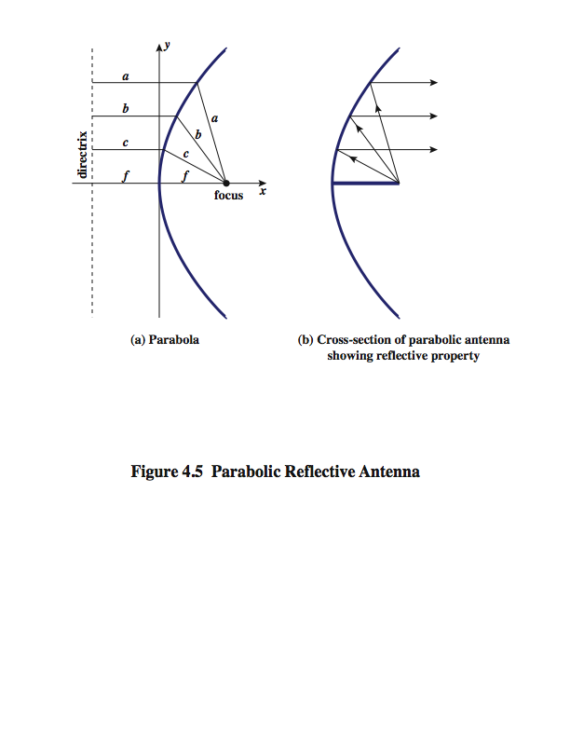
Parabolic Reflective Antenna
Prof S.A Adeshina
NILE
Notes:
An important type of antenna is the parabolic reflective antenna, which is used in terrestrial microwave and satellite applications. A parabola is the locus of all points equidistant from a fixed line (the directrix) and a fixed point (the focus) not on the line, as shown in Stallings DCC8e Figure 4.5a above. If a parabola is revolved about its axis, the surface generated is called a paraboloid.
Paraboloid surfaces are used in headlights, optical and radio telescopes, and microwave antennas because: If a source of electromagnetic energy (or sound) is placed at the focus of the paraboloid, and if the paraboloid is a reflecting surface, then the wave will bounce back in lines parallel to the axis of the paraboloid; as shown in Stallings DCC8e Figure 4.5b above. In theory, this effect creates a parallel beam without dispersion. In practice, there will be some dispersion, because the source of energy must occupy more than one point. The larger the diameter of the antenna, the more tightly directional is the beam. On reception, if incoming waves are parallel to the axis of the reflecting paraboloid, the resulting signal will be concentrated at the focus.

Slide 91
Antenna Gain
measure of directionality of antenna
power output in particular direction verses that produced by an isotropic antenna
measured in decibels (dB)
results in loss in power in another direction
effective area relates to size and shape
related to gain
Prof S.A Adeshina
NILE
Notes:
Antenna gain is a measure of the directionality of an antenna. Antenna gain is defined as the power output, in a particular direction, compared to that produced in any direction by a perfect omnidirectional antenna (isotropic antenna). For example, if an antenna has a gain of 3 dB, that antenna improves upon the isotropic antenna in that direction by 3 dB, or a factor of 2. The increased power radiated in a given direction is at the expense of other directions. In effect, increased power is radiated in one direction by reducing the power radiated in other directions. It is important to note that antenna gain does not refer to obtaining more output power than input power but rather to directionality.
A concept related to that of antenna gain is the effective area of an antenna. The effective area of an antenna is related to the physical size of the antenna and to its shape, as shown in equation 4.1.

Slide 92
Terrestrial Microwave
used for long haul telecommunications
and short point-to-point links
requires fewer repeaters but line of sight
use a parabolic dish to focus a narrow beam onto a receiver antenna
1-40GHz frequencies
higher frequencies give higher data rates
main source of loss is attenuation
distance, rainfall
also interference
Prof S.A Adeshina
NILE
Notes:
The primary use for terrestrial microwave systems is in long haul telecommunications service, as an alternative to coaxial cable or optical fiber. The microwave facility requires far fewer amplifiers or repeaters than coaxial cable over the same distance, (typically every 10-100 km) but requires line-of-sight transmission. Microwave is commonly used for both voice and television transmission. Another increasingly common use of microwave is for short point-to-point links between buildings, for closed-circuit TV or as a data link between local area networks.
The most common type of microwave antenna is the parabolic "dish”, fixed rigidly to focus a narrow beam on a receiving antenna A typical size is about 3 m in diameter. Microwave antennas are usually located at substantial heights above ground level to extend the range between antennas and to be able to transmit over intervening obstacles. To achieve long-distance transmission, a series of microwave relay towers is used, and point-to-point microwave links are strung together over the desired distance.
Microwave transmission covers a substantial portion of the electromagnetic spectrum, typically in the range 1 to 40 GHz, with 4-6GHz and now 11GHz bands the most common. The higher the frequency used, the higher the potential bandwidth and therefore the higher the potential data rate. As with any transmission system, a main source of loss is attenuation, related to the square of distance. The effects of rainfall become especially noticeable above 10 GHz. Another source of impairment is interference.

Slide 93
Satellite Microwave
satellite is relay station
receives on one frequency, amplifies or repeats signal and transmits on another frequency
eg. uplink 5.925-6.425 GHz & downlink 3.7-4.2 GHz
typically requires geo-stationary orbit
height of 35,784km
spaced at least 3-4° apart
typical uses
television
long distance telephone
private business networks
global positioning
Prof S.A Adeshina
NILE
Notes:
A communication satellite is, in effect, a microwave relay station. It is used to link two or more ground-based microwave transmitter/receivers, known as earth stations, or ground stations. The satellite receives transmissions on one frequency band (uplink), amplifies or repeats the signal, and transmits it on another frequency (downlink). A single orbiting satellite will operate on a number of frequency bands, called transponder channels, or simply transponders. The optimum frequency range for satellite transmission is in the range 1 to 10 GHz. Most satellites providing point-to-point service today use a frequency bandwidth in the range 5.925 to 6.425 GHz for transmission from earth to satellite (uplink) and a bandwidth in the range 3.7 to 4.2 GHz for transmission from satellite to earth (downlink). This combination is referred to as the 4/6-GHz band, but has become saturated. So the 12/14-GHz band has been developed (uplink: 14 - 14.5 GHz; downlink: 11.7 - 12.2 GHz).
For a communication satellite to function effectively, it is generally required that it remain stationary with respect to its position over the earth to be within the line of sight of its earth stations at all times. To remain stationary, the satellite must have a period of rotation equal to the earth's period of rotation, which occurs at a height of 35,863 km at the equator. Two satellites using the same frequency band, if close enough together, will interfere with each other. To avoid this, current standards require a 4° spacing in the 4/6-GHz band and a 3° spacing at 12/14 GHz. Thus the number of possible satellites is quite limited.
Among the most important applications for satellites are: Television distribution, Long-distance telephone transmission, Private business networks, and Global positioning.

Slide 94
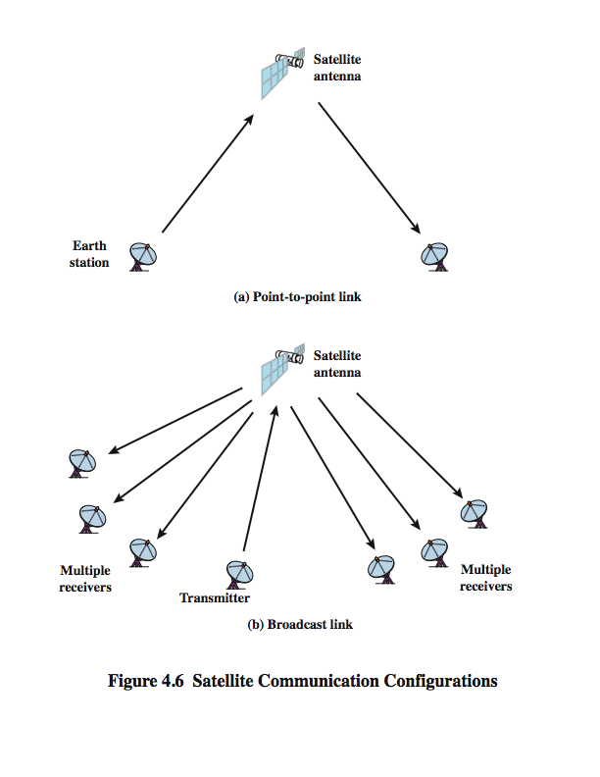
Satellite Point to Point Link
Prof S.A Adeshina
NILE
Notes:
Stallings DCC8e Figure 4.6 depicts in a general way two common configurations for satellite communication. In the first, the satellite is being used to provide a point-to-point link between two distant ground-based antennas.

Slide 95
Satellite Broadcast Link
Prof S.A Adeshina
NILE
Notes:
Stallings DCC8e Figure 4.6 depicts in a general way two common configurations for satellite communication. In the second, the satellite provides communications between one ground-based transmitter and a number of ground-based receivers.

Slide 96
Broadcast Radio
radio is 3kHz to 300GHz
use broadcast radio, 30MHz - 1GHz, for:
FM radio
UHF and VHF television
is omnidirectional
still need line of sight
suffers from multipath interference
reflections from land, water, other objects
Prof S.A Adeshina
NILE
Notes:
Radio is a general term used to encompass frequencies in the range of 3 kHz to 300 GHz. We are using the informal term broadcast radio to cover the VHF and part of the UHF band: 30 MHz to 1 GHz. This range covers FM radio and UHF and VHF television. This range is also used for a number of data networking applications. The principal difference between broadcast radio and microwave is that the former is omnidirectional and the latter is directional. Thus broadcast radio does not require dish-shaped antennas, and the antennas need not be rigidly mounted to a precise alignment.
The range 30 MHz to 1 GHz is an effective one for broadcast communications. Unlike the case for lower-frequency electromagnetic waves, the ionosphere is transparent to radio waves above 30 MHz. Thus transmission is limited to the line of sight, and distant transmitters will not interfere with each other due to reflection from the atmosphere. Unlike the higher frequencies of the microwave region, broadcast radio waves are less sensitive to attenuation from rainfall. A prime source of impairment for broadcast radio waves is multipath interference. Reflection from land, water, and natural or human-made objects can create multiple paths between antennas, eg ghosting on TV pictures.

Slide 97
Infrared
modulate noncoherent infrared light
end line of sight (or reflection)
are blocked by walls
no licenses required
typical uses
TV remote control
IRD port
Prof S.A Adeshina
NILE
Notes:
Infrared communications is achieved using transmitters/receivers (transceivers) that modulate noncoherent infrared light. Transceivers must be within the line of sight of each other either directly or via reflection from a light-colored surface such as the ceiling of a room.
One important difference between infrared and microwave transmission is that the former does not penetrate walls. Thus the security and interference problems encountered in microwave systems are not present. Furthermore, there is no frequency allocation issue with infrared, because no licensing is required.

Slide 98
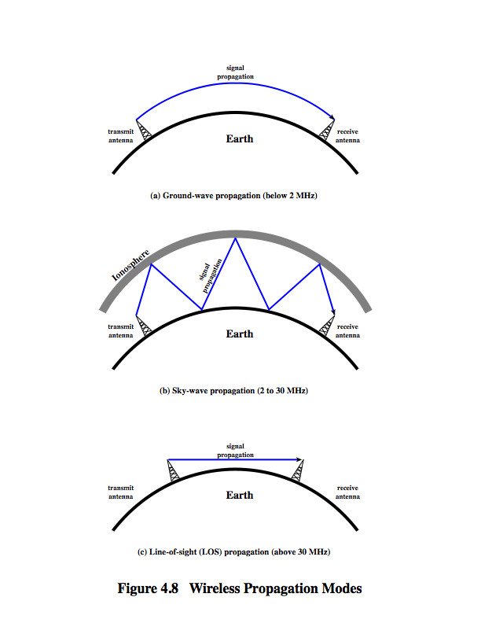
Wireless Propagation Ground Wave
Prof S.A Adeshina
NILE
Notes:
A signal radiated from an antenna travels along one of three routes: ground wave, sky wave, or line of sight (LOS), as shown in Stallings DCC8e Figure 4.8.
Ground wave propagation more or less follows the contour of the earth and can propagate considerable distances, well over the visual horizon. This effect is found in frequencies up to about 2 MHz. Several factors account for the tendency of electromagnetic wave in this frequency band to follow the earth's curvature. One factor is that the electromagnetic wave induces a current in the earth's surface, the result of which is to slow the wavefront near the earth, causing the wavefront to tilt downward and hence follow the earth's curvature. Another factor is diffraction, which is a phenomenon having to do with the behavior of electromagnetic waves in the presence of obstacles. Electromagnetic waves in this frequency range are scattered by the atmosphere in such a way that they do not penetrate the upper atmosphere. The best-known example of ground wave communication is AM radio.

Slide 99
Wireless Propagation Sky Wave
Prof S.A Adeshina
NILE
Notes:
Sky wave propagation is used for amateur radio, CB radio, and international broadcasts such as BBC and Voice of America. With sky wave propagation, a signal from an earth-based antenna is reflected from the ionized layer of the upper atmosphere (ionosphere) back down to earth. Although it appears the wave is reflected from the ionosphere as if the ionosphere were a hard reflecting surface, the effect is in fact caused by refraction. Refraction is described subsequently. A sky wave signal can travel through a number of hops, bouncing back and forth between the ionosphere and the earth's surface, as shown in Stallings DCC8e Figure 4.8b. With this propagation mode, a signal can be picked up thousands of kilometers from the transmitter.

Slide 100
Wireless Propagation Line of Sight
Prof S.A Adeshina
NILE
Notes:
Above 30 MHz, neither ground wave nor sky wave propagation modes operate, and communication must be by line of sight (Stallings DCC8e Figure 4.8c). For satellite communication, a signal above 30 MHz is not reflected by the ionosphere and therefore a signal can be transmitted between an earth station and a satellite overhead that is not beyond the horizon. For ground-based communication, the transmitting and receiving antennas must be within an effective line of sight of each other. The term effective is used because microwaves are bent or refracted by the atmosphere. The amount and even the direction of the bend depends on conditions, but generally microwaves are bent with the curvature of the earth and will therefore propagate farther than the optical line of sight. In this book, we are almost exclusively concerned with LOS communications.

Slide 101
Line of Sight Transmission
Free space loss
loss of signal with distance
Atmospheric Absorption
from water vapour and oxygen absorption
Multipath
multiple interfering signals from reflections
Refraction
bending signal away from receiver
Prof S.A Adeshina
NILE
Notes:
Stallings DCC8e section 3.3 discussed various transmission impairments common to both guided and wireless transmission. In this section, we extend the discussion to examine some impairments specific to wireless line-of-sight transmission.
For any type of wireless communication the signal disperses with distance. Therefore, an antenna with a fixed area will receive less signal power the farther it is from the transmitting antenna. For satellite communication this is the primary mode of signal loss. Even if no other sources of attenuation or impairment are assumed, a transmitted signal attenuates over distance because the signal is being spread over a larger and larger area. This form of attenuation is known as free space loss.
An additional loss between the transmitting and receiving antennas is atmospheric absorption. Water vapor and oxygen contribute most to attenuation. A peak attenuation occurs in the vicinity of 22 GHz due to water vapor. At frequencies below 15 GHz, the attenuation is less. The presence of oxygen results in an absorption peak in the vicinity of 60 GHz but contributes less at frequencies below 30 GHz. Rain and fog (suspended water droplets) cause scattering of radio waves that results in attenuation.
For some wireless systems, there are obstacles in abundance. The signal can be reflected by such obstacles so that multiple copies of the signal with varying delays can be received, resulting in multipath interference. Depending on the differences in the path lengths of the direct and reflected waves, the composite signal can be either larger or smaller than the direct signal.
Radio waves are refracted (or bent) when they propagate through the atmosphere. Normally, the speed of the signal increases with altitude, causing radio waves to bend downward. However, on occasion, weather conditions may lead to variations in speed with height that differ significantly from the typical variations. This may result in a situation in which only a fraction or no part of the line-of-sight wave reaches the receiving antenna.

Slide 102
Summary
looked at data transmission issues
frequency, spectrum & bandwidth
analog vs digital signals
transmission impairments
Prof S.A Adeshina
NILE
Notes:
Stallings DCC8e Chapter 4 summary.

Slide 103
Wireless Transmission Frequencies
2GHz to 40GHz
microwave
highly directional
point to point
satellite
30MHz to 1GHz
omnidirectional
broadcast radio
3 x 10¹¹ to 2 x 10¹⁴
infrared
local
Prof S.A Adeshina
NILE
Notes:
Unguided transmission techniques commonly used for information communications include broadcast radio, terrestrial microwave, and satellite. Infrared transmission is used in some LAN applications. Three general ranges of frequencies are of interest in our discussion of wireless transmission.
Frequencies in the range of about 1 to 40 GHz are referred to as microwave frequencies. At these frequencies, highly directional beams are possible, and microwave is quite suitable for point-to-point transmission. Microwave is also used for satellite communications.
Frequencies in the range of 30 MHz to 1 GHz are suitable for omnidirectional applications. We refer to this range as the radio range.
Another important frequency range is the infrared portion of the spectrum, roughly from 3 × 10¹¹ to 2 × 10¹⁴ Hz. Infrared is useful to local point-to-point and multipoint applications within confined areas, such as a single room.

Slide 104
Antennas
electrical conductor used to radiate or collect electromagnetic energy
transmission antenna
radio frequency energy from transmitter
converted to electromagnetic energy byy antenna
radiated into surrounding environment
reception antenna
electromagnetic energy impinging on antenna
converted to radio frequency electrical energy
fed to receiver
same antenna is often used for both purposes
Prof S.A Adeshina
NILE
Notes:
For unguided media, transmission and reception are achieved by means of an antenna. An antenna can be defined as an electrical conductor or system of conductors used either for radiating electromagnetic energy or for collecting electromagnetic energy.
For transmission of a signal, radio-frequency electrical energy from the transmitter is converted into electromagnetic energy by the antenna and radiated into the surrounding environment.
For reception of a signal, electromagnetic energy impinging on the antenna is converted into radio-frequency electrical energy and fed into the receiver.
In two-way communication, the same antenna can be and often is used for both transmission and reception. This is possible because antenna characteristics are essentially the same whether an antenna is sending or receiving electromagnetic energy.

Slide 105
Radiation Pattern
power radiated in all directions
not same performance in all directions
as seen in a radiation pattern diagram
an isotropic antenna is a (theoretical) point in space
radiates in all directions equally
with a spherical radiation pattern
Prof S.A Adeshina
NILE
Notes:
An antenna will radiate power in all directions but, typically, does not perform equally well in all directions. A common way to characterize the performance of an antenna is the radiation pattern, which is a graphical representation of the radiation properties of an antenna as a function of space coordinates.
The simplest pattern is produced by an idealized antenna known as the isotropic antenna. An isotropic antenna is a point in space that radiates power in all directions equally. The actual radiation pattern for the isotropic antenna is a sphere with the antenna at the center.

Slide 106
Parabolic Reflective Antenna
Prof S.A Adeshina
NILE
Notes:
An important type of antenna is the parabolic reflective antenna, which is used in terrestrial microwave and satellite applications. A parabola is the locus of all points equidistant from a fixed line (the directrix) and a fixed point (the focus) not on the line, as shown in Stallings DCC8e Figure 4.5a above. If a parabola is revolved about its axis, the surface generated is called a paraboloid.
Paraboloid surfaces are used in headlights, optical and radio telescopes, and microwave antennas because: If a source of electromagnetic energy (or sound) is placed at the focus of the paraboloid, and if the paraboloid is a reflecting surface, then the wave will bounce back in lines parallel to the axis of the paraboloid; as shown in Stallings DCC8e Figure 4.5b above. In theory, this effect creates a parallel beam without dispersion. In practice, there will be some dispersion, because the source of energy must occupy more than one point. The larger the diameter of the antenna, the more tightly directional is the beam. On reception, if incoming waves are parallel to the axis of the reflecting paraboloid, the resulting signal will be concentrated at the focus.

Slide 107
Antenna Gain
measure of directionality of antenna
power output in particular direction verses that produced by an isotropic antenna
measured in decibels (dB)
results in loss in power in another direction
effective area relates to size and shape
related to gain
Prof S.A Adeshina
NILE
Notes:
Antenna gain is a measure of the directionality of an antenna. Antenna gain is defined as the power output, in a particular direction, compared to that produced in any direction by a perfect omnidirectional antenna (isotropic antenna). For example, if an antenna has a gain of 3 dB, that antenna improves upon the isotropic antenna in that direction by 3 dB, or a factor of 2. The increased power radiated in a given direction is at the expense of other directions. In effect, increased power is radiated in one direction by reducing the power radiated in other directions. It is important to note that antenna gain does not refer to obtaining more output power than input power but rather to directionality.
A concept related to that of antenna gain is the effective area of an antenna. The effective area of an antenna is related to the physical size of the antenna and to its shape, as shown in equation 4.1.

Slide 108
Terrestrial Microwave
used for long haul telecommunications
and short point-to-point links
requires fewer repeaters but line of sight
use a parabolic dish to focus a narrow beam onto a receiver antenna
1-40GHz frequencies
higher frequencies give higher data rates
main source of loss is attenuation
distance, rainfall
also interference
Prof S.A Adeshina
NILE
Notes:
The primary use for terrestrial microwave systems is in long haul telecommunications service, as an alternative to coaxial cable or optical fiber. The microwave facility requires far fewer amplifiers or repeaters than coaxial cable over the same distance, (typically every 10-100 km) but requires line-of-sight transmission. Microwave is commonly used for both voice and television transmission. Another increasingly common use of microwave is for short point-to-point links between buildings, for closed-circuit TV or as a data link between local area networks.
The most common type of microwave antenna is the parabolic "dish”, fixed rigidly to focus a narrow beam on a receiving antenna A typical size is about 3 m in diameter. Microwave antennas are usually located at substantial heights above ground level to extend the range between antennas and to be able to transmit over intervening obstacles. To achieve long-distance transmission, a series of microwave relay towers is used, and point-to-point microwave links are strung together over the desired distance.
Microwave transmission covers a substantial portion of the electromagnetic spectrum, typically in the range 1 to 40 GHz, with 4-6GHz and now 11GHz bands the most common. The higher the frequency used, the higher the potential bandwidth and therefore the higher the potential data rate. As with any transmission system, a main source of loss is attenuation, related to the square of distance. The effects of rainfall become especially noticeable above 10 GHz. Another source of impairment is interference.

Slide 109
Satellite Microwave
satellite is relay station
receives on one frequency, amplifies or repeats signal and transmits on another frequency
eg. uplink 5.925-6.425 GHz & downlink 3.7-4.2 GHz
typically requires geo-stationary orbit
height of 35,784km
spaced at least 3-4° apart
typical uses
television
long distance telephone
private business networks
global positioning
Prof S.A Adeshina
NILE
Notes:
A communication satellite is, in effect, a microwave relay station. It is used to link two or more ground-based microwave transmitter/receivers, known as earth stations, or ground stations. The satellite receives transmissions on one frequency band (uplink), amplifies or repeats the signal, and transmits it on another frequency (downlink). A single orbiting satellite will operate on a number of frequency bands, called transponder channels, or simply transponders. The optimum frequency range for satellite transmission is in the range 1 to 10 GHz. Most satellites providing point-to-point service today use a frequency bandwidth in the range 5.925 to 6.425 GHz for transmission from earth to satellite (uplink) and a bandwidth in the range 3.7 to 4.2 GHz for transmission from satellite to earth (downlink). This combination is referred to as the 4/6-GHz band, but has become saturated. So the 12/14-GHz band has been developed (uplink: 14 - 14.5 GHz; downlink: 11.7 - 12.2 GHz).
For a communication satellite to function effectively, it is generally required that it remain stationary with respect to its position over the earth to be within the line of sight of its earth stations at all times. To remain stationary, the satellite must have a period of rotation equal to the earth's period of rotation, which occurs at a height of 35,863 km at the equator. Two satellites using the same frequency band, if close enough together, will interfere with each other. To avoid this, current standards require a 4° spacing in the 4/6-GHz band and a 3° spacing at 12/14 GHz. Thus the number of possible satellites is quite limited.
Among the most important applications for satellites are: Television distribution, Long-distance telephone transmission, Private business networks, and Global positioning.

Slide 110
Satellite Point to Point Link
Prof S.A Adeshina
NILE
Notes:
Stallings DCC8e Figure 4.6 depicts in a general way two common configurations for satellite communication. In the first, the satellite is being used to provide a point-to-point link between two distant ground-based antennas.

Slide 111
Satellite Broadcast Link
Prof S.A Adeshina
NILE
Notes:
Stallings DCC8e Figure 4.6 depicts in a general way two common configurations for satellite communication. In the second, the satellite provides communications between one ground-based transmitter and a number of ground-based receivers.

Slide 112
Broadcast Radio
radio is 3kHz to 300GHz
use broadcast radio, 30MHz - 1GHz, for:
FM radio
UHF and VHF television
is omnidirectional
still need line of sight
suffers from multipath interference
reflections from land, water, other objects
Prof S.A Adeshina
NILE
Notes:
Radio is a general term used to encompass frequencies in the range of 3 kHz to 300 GHz. We are using the informal term broadcast radio to cover the VHF and part of the UHF band: 30 MHz to 1 GHz. This range covers FM radio and UHF and VHF television. This range is also used for a number of data networking applications. The principal difference between broadcast radio and microwave is that the former is omnidirectional and the latter is directional. Thus broadcast radio does not require dish-shaped antennas, and the antennas need not be rigidly mounted to a precise alignment.
The range 30 MHz to 1 GHz is an effective one for broadcast communications. Unlike the case for lower-frequency electromagnetic waves, the ionosphere is transparent to radio waves above 30 MHz. Thus transmission is limited to the line of sight, and distant transmitters will not interfere with each other due to reflection from the atmosphere. Unlike the higher frequencies of the microwave region, broadcast radio waves are less sensitive to attenuation from rainfall. A prime source of impairment for broadcast radio waves is multipath interference. Reflection from land, water, and natural or human-made objects can create multiple paths between antennas, eg ghosting on TV pictures.

Slide 113
Infrared
modulate noncoherent infrared light
end line of sight (or reflection)
are blocked by walls
no licenses required
typical uses
TV remote control
IRD port
Prof S.A Adeshina
NILE
Notes:
Infrared communications is achieved using transmitters/receivers (transceivers) that modulate noncoherent infrared light. Transceivers must be within the line of sight of each other either directly or via reflection from a light-colored surface such as the ceiling of a room.
One important difference between infrared and microwave transmission is that the former does not penetrate walls. Thus the security and interference problems encountered in microwave systems are not present. Furthermore, there is no frequency allocation issue with infrared, because no licensing is required.

Slide 114
Wireless Propagation Ground Wave
Prof S.A Adeshina
NILE
Notes:
A signal radiated from an antenna travels along one of three routes: ground wave, sky wave, or line of sight (LOS), as shown in Stallings DCC8e Figure 4.8.
Ground wave propagation more or less follows the contour of the earth and can propagate considerable distances, well over the visual horizon. This effect is found in frequencies up to about 2 MHz. Several factors account for the tendency of electromagnetic wave in this frequency band to follow the earth's curvature. One factor is that the electromagnetic wave induces a current in the earth's surface, the result of which is to slow the wavefront near the earth, causing the wavefront to tilt downward and hence follow the earth's curvature. Another factor is diffraction, which is a phenomenon having to do with the behavior of electromagnetic waves in the presence of obstacles. Electromagnetic waves in this frequency range are scattered by the atmosphere in such a way that they do not penetrate the upper atmosphere. The best-known example of ground wave communication is AM radio.

Slide 115
Wireless Propagation Sky Wave
Prof S.A Adeshina
NILE
Notes:
Sky wave propagation is used for amateur radio, CB radio, and international broadcasts such as BBC and Voice of America. With sky wave propagation, a signal from an earth-based antenna is reflected from the ionized layer of the upper atmosphere (ionosphere) back down to earth. Although it appears the wave is reflected from the ionosphere as if the ionosphere were a hard reflecting surface, the effect is in fact caused by refraction. Refraction is described subsequently. A sky wave signal can travel through a number of hops, bouncing back and forth between the ionosphere and the earth's surface, as shown in Stallings DCC8e Figure 4.8b. With this propagation mode, a signal can be picked up thousands of kilometers from the transmitter.

Slide 116
Wireless Propagation Line of Sight
Prof S.A Adeshina
NILE
Notes:
Above 30 MHz, neither ground wave nor sky wave propagation modes operate, and communication must be by line of sight (Stallings DCC8e Figure 4.8c). For satellite communication, a signal above 30 MHz is not reflected by the ionosphere and therefore a signal can be transmitted between an earth station and a satellite overhead that is not beyond the horizon. For ground-based communication, the transmitting and receiving antennas must be within an effective line of sight of each other. The term effective is used because microwaves are bent or refracted by the atmosphere. The amount and even the direction of the bend depends on conditions, but generally microwaves are bent with the curvature of the earth and will therefore propagate farther than the optical line of sight. In this book, we are almost exclusively concerned with LOS communications.

Slide 117
Review
Physical layer (Guided and Unguarded links)
Communication concepts
Switching
Multiplexing
ATM
DWDM
Networking Concepts
WAN, LAN, FIBRE OPTICS
Wireless Communications
Microwave comm, Radio, Sattellite, Lo
Prof S.A Adeshina
NILE

